Slide 1

A New Public Private Partnership:
Catastrophic Public and Front-End Private Long Term Care Insurance
Forum on Long-Term Care Financing
McNamara Alumni Center – University of Minnesota
By
Marc A. Cohen, Ph.D.
January 7, 2020
Co-Director, LeadingAge LTSS Center @UMass Boston and Research Director, Center for Consumer Engagement in Health Innovation, Community Catalyst.

Slide 2
Purpose
Provide background on the magnitude of the long-term services and supports (LTSS) financing challenge.
Characterize current approaches and challenges associated with financing care.
  Public approaches
  Private approaches
Present a new approach for harnessing the public and private sectors to move the financing system from a welfare-based model toward an insurance model.

Slide 3
The LTSS financing challenge is BIG
Roughly 25 million of today’s seniors will need LTSS services (paid and unpaid) and costs will exceed $2.5 trillion over 10 years.
  Note that 40% of those needing LTSS today are under age 65.
Americans are unprepared to absorb potential LTSS costs.
  Most people are not poor enough to immediately qualify for the social safety net so they are most exposed to potentially catastrophic costs;
  The expected costs of LTSS would account for about 31% of the net worth of households with a head aged 65-74;
  Only the wealthiest 10% to 15% have savings equivalent to cover these costs;
  Projected need and lack of financial protection leaves families with ever increasing caregiving burdens.
In short, LTSS needs undermine individuals preparedness for retirement – where there is already a concerning shortfall.

Slide 4
Expected costs of LTSS to individuals who are turning age 65 today and needing significant care in the future
(2015 dollars)
Average lifetime costs exceed $266,000, when focusing exclusively on those who use care
Source: ASPE Issue Brief on LTC Financing, July 2015, https://aspe.hhs.gov/basic-report/long-term-services-and-supports-older-americans-risks-and-financing-research-brief

Slide 5
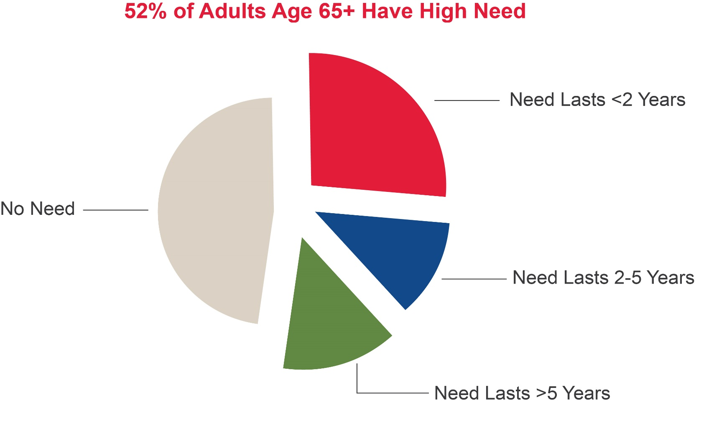
Among those with a high level of need, the LTSS risk is highly skewed
27%
48%
12%
14%
Source: Ann Tumlinson Innovations based on Favreault & Dey (2015) Table 1. https://www.thescanfoundation.org/sites/default/files/financing_long-term_care_chartpack_092016_final.pptx

Slide 6
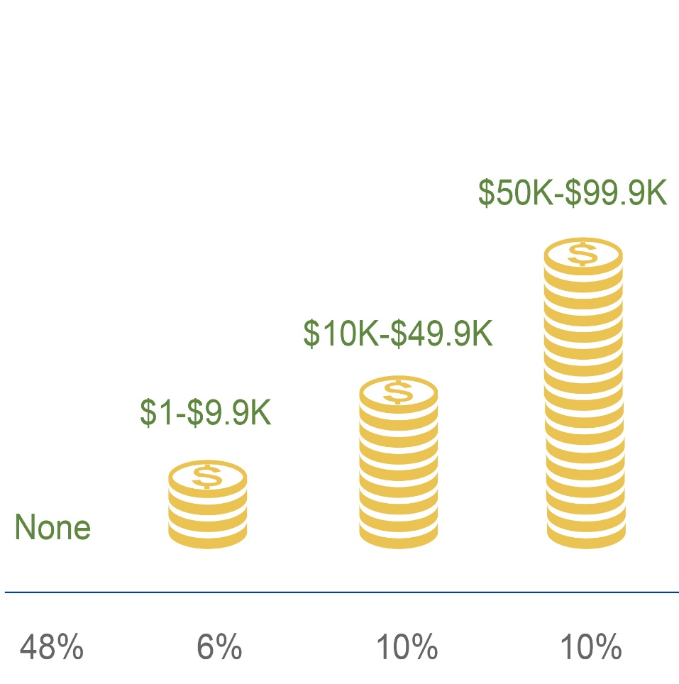
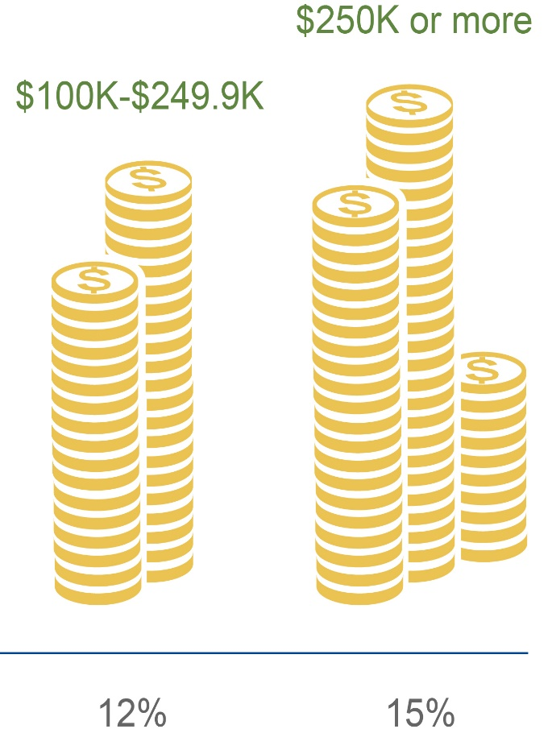
Because utilization is skewed, so too is the distribution of future expected costs
Source: Favreault & Dey (2015), Table 5 in Anne Tumlinson Innovations presented to SCAN Foundation, 2016. https://www.thescanfoundation.org/sites/default/files/financing_long-term_care_chartpack_092016_final.pptx

Slide 7
Current approaches to financing LTSS services
Primary Public approaches (Federal, state and local)
  Medicaid
  Public education about risks and costs to spur action
Primary Private Approaches (insurance and savings)
  Current income, savings, annuitizing the home
  Private long-term care insurance
Mixed Approaches (public trying to push private)
  Partnership Programs between states and Federal government (45 states)
  Federal and state tax incentives for LTC insurance purchase (30 states)
  State employee LTC insurance programs (27 states)

Slide 8
Challenges with Medicaid financing
Obtaining eligibility through spend-down is threat to many individuals’ financial security.
Waiting lists and access limits for home and community-based care.
Less flexibility in service provision.
States struggling with budget pressures.
  LTSS is approaching 30% to 45% of state Medicaid budgets and growing rapidly.
Reimbursement rates often do not support development of a high quality workforce and service infrastructure.

Slide 9
Challenges with Reliance on Private Long-Term Care Insurance
Only 7-8 million people have policies and premiums for stand-alone policies are now out of the reach of the broad middle class.
  Roughly 200,000 policyholders in Minnesota accounting for 3% of US total
Prior two decade saw a major exodus of companies from the market, as returns on the product have been significantly below expectation.
  Only a dozen or so companies remain in market compared to over 100 in the year 2000.
Underwriting stringency excludes growing number of applicants – upwards of 30% of the target population. (https://www.healthaffairs.org/doi/full/10.1377/hlthaff.2015.1133)
Major rate increases have unnerved consumers.
Growth in combination products does represent a bright spot.

Slide 10
Reliance on Families alone is becoming more difficult
Family caregivers currently provide 37 billion hours of care at an economic value about $470 billion¹ -- > 6x the amount paid by public payers.
By 2050, for every person 80 or older, there will be only three people of peak caregiving age compared to seven today.
The family caregiver network is experiencing unprecedented challenges due to:
  Smaller family size;
  The increasing employment mobility of children;
  Strains associated with “Sandwich Generation” are turning it into the “Panini Generation.”
Many elders currently have significant unmet need.
Number of people needing significant assistance will grow by 149% from 6.3 million to 15.7 million in fifty years.
¹ Also includes care to those less than age 65 with need

Slide 11
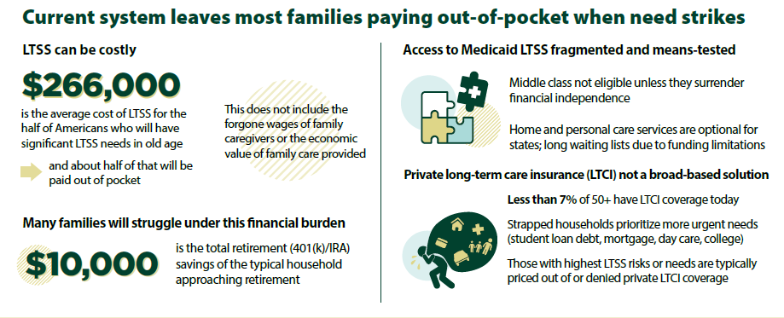
Where does this leave us?
Source: Veghte, Cohen, Tell and Bradley. “Designing a State-based Social Insurance Program for Long-Term Services and Supports. Washington DC. National Academy of Social Insurance. 2019. https://www.nasi.org/research/2019/designing-universal-family-care-state-based-social-insurance

Slide 12
Fundamental LTSS financing problem:
Absence of an effective insurance mechanism
The distribution of risk makes LTSS perfectly suited to an insurance solution.
  Many people will have no need and a small number will be have catastrophic expenses;
  It is difficult to predict where you might fall in the distribution of risk;
  Even for the few who have the resources, savings does not make sense and it unreasonable to expect people to set aside money for this risk.

Slide 13
Philosophical Conflict
Agreement on reform strategy has been absent because of fundamental philosophical conflict.
  Those who would limit public policy to the promotion of private insurance;
  Those who regard public insurance as essential to the assurance of adequate, affordable protection.
Number of groups -- Long-Term Care Financing Collaborative, LeadingAge, Bipartisan Policy Center -- have recently come together representing both points of view.
  Leaning in direction of new public-private partnership that moves system away from welfare-basis toward insurance-basis.
Sources: https://www.convergencepolicy.org/wp-content/uploads/2016/02/LTCFC-FINAL-REPORT-Feb-2016.pdf; https://bipartisanpolicy.org/report/financing-long-term-services-and-supports/; https://www.leadingage.org/sites/default/files/Pathways_Report_February_2016.pdf

Slide 14
A New Public-Private Partnership:
Catastrophic Public and Front-End Private LTC Insurance
Marc Cohen, Ph.D.¹
Judith Feder, Ph.D.²
Melissa Favreault, Ph.D.³
¹ Co-Director LeadingAge LTSS Center @UMass Boston, Research Director, Center for Consumer Engagement in Health Innovation, Community Catalyst, Boston
² Professor, McCourt School of Public Policy at Georgetown University and Urban Institute Fellow, Urban Institute, Washington, D.C.
³ Senior Fellow, Urban Institute, Washington, D.C.
https://bipartisanpolicy.org/wp-content/uploads/2018/01/Public-Catastrophic-Insurance-Paper-for-Bipartisan-Policy-Center-1-25-2018.pdf

Slide 15
Why Public Insurance for “Back-end” Risk?
Private insurance carriers are unwilling to provide protection for the uncapped back-end risk.
    Less than 10% of new policies sold cover this risk and only 1-2 carriers even sell it;
    Difficult to price uncapped risk in the context of voluntary insurance market;
    Premiums associated with the few carriers willing to sell such policies are out of the reach of the vast majority of middle class Americans.
It is the middle class that is most exposed.
    The poor and near-poor have protection through the Medicaid program;
    The wealthy can self-insure so middle income elders are most vulnerable and are the target of public policy.

Slide 16
Why Public Insurance for “Back-end” Risk?
Public costs associated with families trying to address catastrophic costs:
  Added health care costs to family caregivers, which impose societal costs;
  Workforce accommodations and lost wages and productivity to individuals and society;
  Reduced savings for retirement increases future demand on social safety net.
Even with a viable private insurance market:
  There would be under-production of insurance due to unaccounted public costs;
  Not everyone can afford to purchase or would qualify for private insurance coverage.
Does not distort use of paid and unpaid care:
  Public catastrophic protection also benefits people who rely exclusively on family caregiving, rather than insurance, to fill the up-front gap.
Promoting a more robust comprehensive insurance solution is one way to seriously address the persistent issue of unmet needs in the population.

Slide 17
Key Features of Policy Proposal: Two Components
Focus Public Coverage on Back-end or Catastrophic Risk
  The catastrophic event is described in terms of the amount of time one must wait after becoming disabled to receive public insurance benefits;
  The range for such a waiting period is between one to four years and increases as income rises;
  Tying waiting periods to income (shorter for people with lower incomes, longer for people with higher incomes) could make gap-filling private insurance affordable to modest-income people;
  Limit financial exposure to liabilities middle and higher income people can reasonably be expected to manage themselves with insurance or savings.
Revitalize the private insurance market to overcome poor penetration and underperformance
Private insurers can market products as first dollar protection, to encourage modest and higher income people to purchase policies to build comprehensive insurance protection.
  Reducing the marketing costs of the product;
  Reducing product complexity;
  Changing product pricing strategies;
  Reforming elements of insurance regulation, and
  Repurposing current tax subsidies to assure that benefits are targeted to reach potential middle- and lower-income purchasers.

Slide 18
Key Parameters of Public Insurance Plan
Description: A public catastrophic insurance program for LTSS costs that takes effect after an income-related waiting period has been met; A package of actions designed to spur development of affordable products and significant growth in the private long-term care insurance market.
Eligibility and Phase-In: People who have satisfied 40 quarters of employment on or after January 1, 2015 (that is, at least by January 1, 2025) would be eligible for the benefit
Coverage/Benefits: Up to $110/day cash benefit (2014 dollars) Higher benefits for those who paid in longer (if financing is voluntary) Paid out either daily or weekly Unlimited benefit once an income related waiting period is met Waiting period is 1 to 4 years Annual benefits increase at the rate that hourly costs increase for home health aide workers Single disability tier (HIPAA benefit triggers of 2+ ADLs and/or severe cognitive impairment)
Financing: Premium surcharge on Medicare tax Medicaid savings due to substitution of new public benefit plus potential impact of higher insurance take-up

Slide 19
Key Parameters of Private Insurance Package
Reducing Marketing Costs Targeted public education campaign Market private coverage with public coverage On-line access to policies and on insurance exchanges Require employers to offer coverage as an optional benefit with “opt out” approach Make available as part of other health insurance offerings (MA/Medigap)
Reforming Product Pricing Move away from level-funded products toward “term-basis”, much like life insurance Index both premiums and benefits to account for increases in the cost of services. Allow products with long waiting periods for those who want to self-insure
Reforming Insurance Regulation Uniform federal guidelines that apply across all states based on current NAIC guidelines Provide companies some guarantee of rate relief when changes in the environment—like the great recession—affect underlying pricing assumptions
Targeting Tax Benefits Re-targeting current tax benefits for LTCI to low- and modest-income people Refundable tax credits to reach individuals in the lower middle class.

Slide 20
Additional Features of Policy Proposal
Encourage Family Care while Limiting Family Risk
  A waiting period based on how long someone is ADL-dependent versus how much they have spent on LTSS services avoids financial barriers to receipt of public benefits;
  Cash benefits
Rely on Mandatory/Automatic Participation and Tax Financing
  Surcharge to the current Medicare tax could achieve broad participation while mitigating additional burdens on lower earners;
  Payroll tax tied to LTSS creates the perception of an “earned” benefit—akin to Social Security and Medicare.
Assure Coverage Pre- as well as Post-Retirement
  For pre-retirement coverage, one could adopt Social Security’s rules shortening “vesting” periods for younger workers who become disabled, and applying income-related waiting periods based on earnings at the point of disability, rather than at retirement;
  Self-funding would necessarily be limited, and thus to meet any level of need general revenues will needed.

Slide 21
Waiting Periods for Public Coverage, by Income Quintile
Waiting Period | Lowest Quintile | Second Quintile | Third Quintile | Fourth Quintile | Fifth Quintile
Family Income Limit for each quintile | $28,894 | $50,520 | $78,000 | $121,059 | >$121,059
Average income | $16,109 | $39,514 | $63,916 | $97,207 | $169,000
Waiting Periods | 1 year | 1 year | 2 years | 3 years | 4 years
U.S. Census Bureau Current Population Survey, Annual Social and Economic Supplements, 2014 https://www.census.gov/hhds/www/income/data/historical/families/.

Slide 22
Relationship Between Income Quintiles and Potential Affordability of Private Insurance Premiums
Waiting Periods: | 1 Year Policy | 2 Year Policy | 3 Year Policy | 4 Year Policy
Adjusted Estimated LTC Insurance Premiums Age 45 Age 50 Age 55 Age 60 Age 65 | $488 $541 $628 $757 $1,012 | $975 $1,082 $1,255 $1,514 $2,023 | $1,251 $1,392 $1,620 $1,961 $2,625 | $1,484 $1,646 $1,908 $2,297 $3,053
Range of Percent of Income that would need to be spent on premiums by families (age 50) Lowest Quintile Second Quintile Third Quintile Fourth Quintile Highest Quintile | 3% - >10% 2% - 3% 1% - 2% 1% <1% | 6% - 15% 4% - 6% 2% - 4% 2% 1% | 8% - 19% 5% - 8% 3% - 5% 2% - 3% 1% - 2% | 10% - 21% 6% - 10% 4% - 6% 2% - 4% 2%

Slide 23
Fixed versus variable waiting period impacts on proportion of 65+ receiving benefits by Socio-demographic characteristics
Characteristic | Income-Related Waiting Period | Fixed Waiting Period at 2.2 Years
Total | 32% | 33%
Gender Men Women | 30% 34 | 30% 36
Marital Status Married Widowed Divorced/Separated Never Married | 30% 39 36 37 | 32% 40 34 34
Percent of Baseline Costs Covered by the Program | 31% | 31%

Slide 24
Fixed versus variable waiting period impacts on proportion of 65+ receiving benefits by disability and income status
Characteristic | Income-Related Waiting Period | Fixed Waiting Period 2.2 Years
Years of Disability age 65+ 1-2 years 2-3 years 3-4 years 4-5 years 5 or more years | 20 39 65 89 96 | 0 60 92 95 96
Income Decile at age 65 Lowest Second Third Fourth Fifth Sixth Seventh Eighth Ninth Highest | 41% 45 43 43 34 35 33 28 22 21 | 34% 36 33 34 34 34 38 32 32 29
Percent of Baseline Costs Covered | 31% | 31%

Slide 25
Sum of LTSS Spending Age 65+ by Payers for Fully-phased in Cohorts Under Baseline and Alternative Waiting Period Options (2015 Dollars)

Slide 26
Summary of Program Benefits
Catastrophic program injects significant new dollars into the LTSS system (an estimated spending increase of 14 percent).
  Enhances benefits for people with impairments of long duration;
  Reduces unmet LTSS needs and mitigating burdens facing family caregivers.
Leads to 15% reduction in financial burden of LTSS felt by millions of families.
Would mitigate fiscal burdens on states by 23% reduction in current Medicaid spending.
Income-based waiting period design reaches more low and modest income families and allocates more spending to them compared to fixed waiting period.
These estimates of impact do not take into account the potential effects of the insurance reforms.
A vibrant market is critically important to assure that middle income people have a way to plan for and address the uncovered front-end LTSS risk.

Slide 27
Public Program Costs
Current Medicare Tax
  1.45% of all earnings for most workers;
  2.35% earnings for workers whose incomes exceed a threshold;
    $250,000 for married taxpayers and $200,000 for single taxpayers
    They pay additional 3.8 percent tax on unearned income
Program Cost
  Additional tax rate of 1 percentage point of earned income split between employers and employees;
  This level of tax is designed to assure fiscal solvency over a 75 year period.
Actual Premium Charge
  The actual premium charge to an employee is about $486 per year or about $41 per month based on total covered wage in 2015 $46,480;
  Split between employees and employers that will be about $21 per month.
Comparison Costs
  $35 per month average internet fee (Time Warner, 2017);
  $148 cell phone cost (Cowen’s Q4 Study 2016);
  $191 monthly spend on restaurants (Source: U.S. Census Bureau and the Bureau of Labor Statistics).

Slide 28
Additional Thoughts and Limitations (1)
Does the complexity of an income-based waiting period warrant the admin & marketing complexity?
  Small differences in the distribution of benefits across income groups and per-person spending reductions.
  Yet, an income-related approach makes private LTCI affordable for modest income people.
Political challenge of a mandatory program with income-conditioned benefits and a highly progressive financing mechanism.
  Could treat the proposed surcharge more as a premium than a tax, by allowing people the opportunity to opt out.
  To limit adverse selection, could give people ability to opt out at various times.
  To encourage early participation, the Medicare tax surcharge might be higher for people nearing retirement.

Slide 29
Additional Thoughts and Limitations (2)
Transition issues
  Reliance on self-funding excludes baby boomers too old or otherwise unable to work and contribute for 40 quarters.
    This can be addressed through additional temporary allocation of general revenues until program is up and running.
  Excludes people already in need of LTSS.
  With no other action current strains on individual, families and state governments will persist for at least another two to three decades.
Even in context of challenges, the analysis shows that there are substantial benefits to a public catastrophic LTSS insurance program supplemented by private insurance reforms.

Slide 30
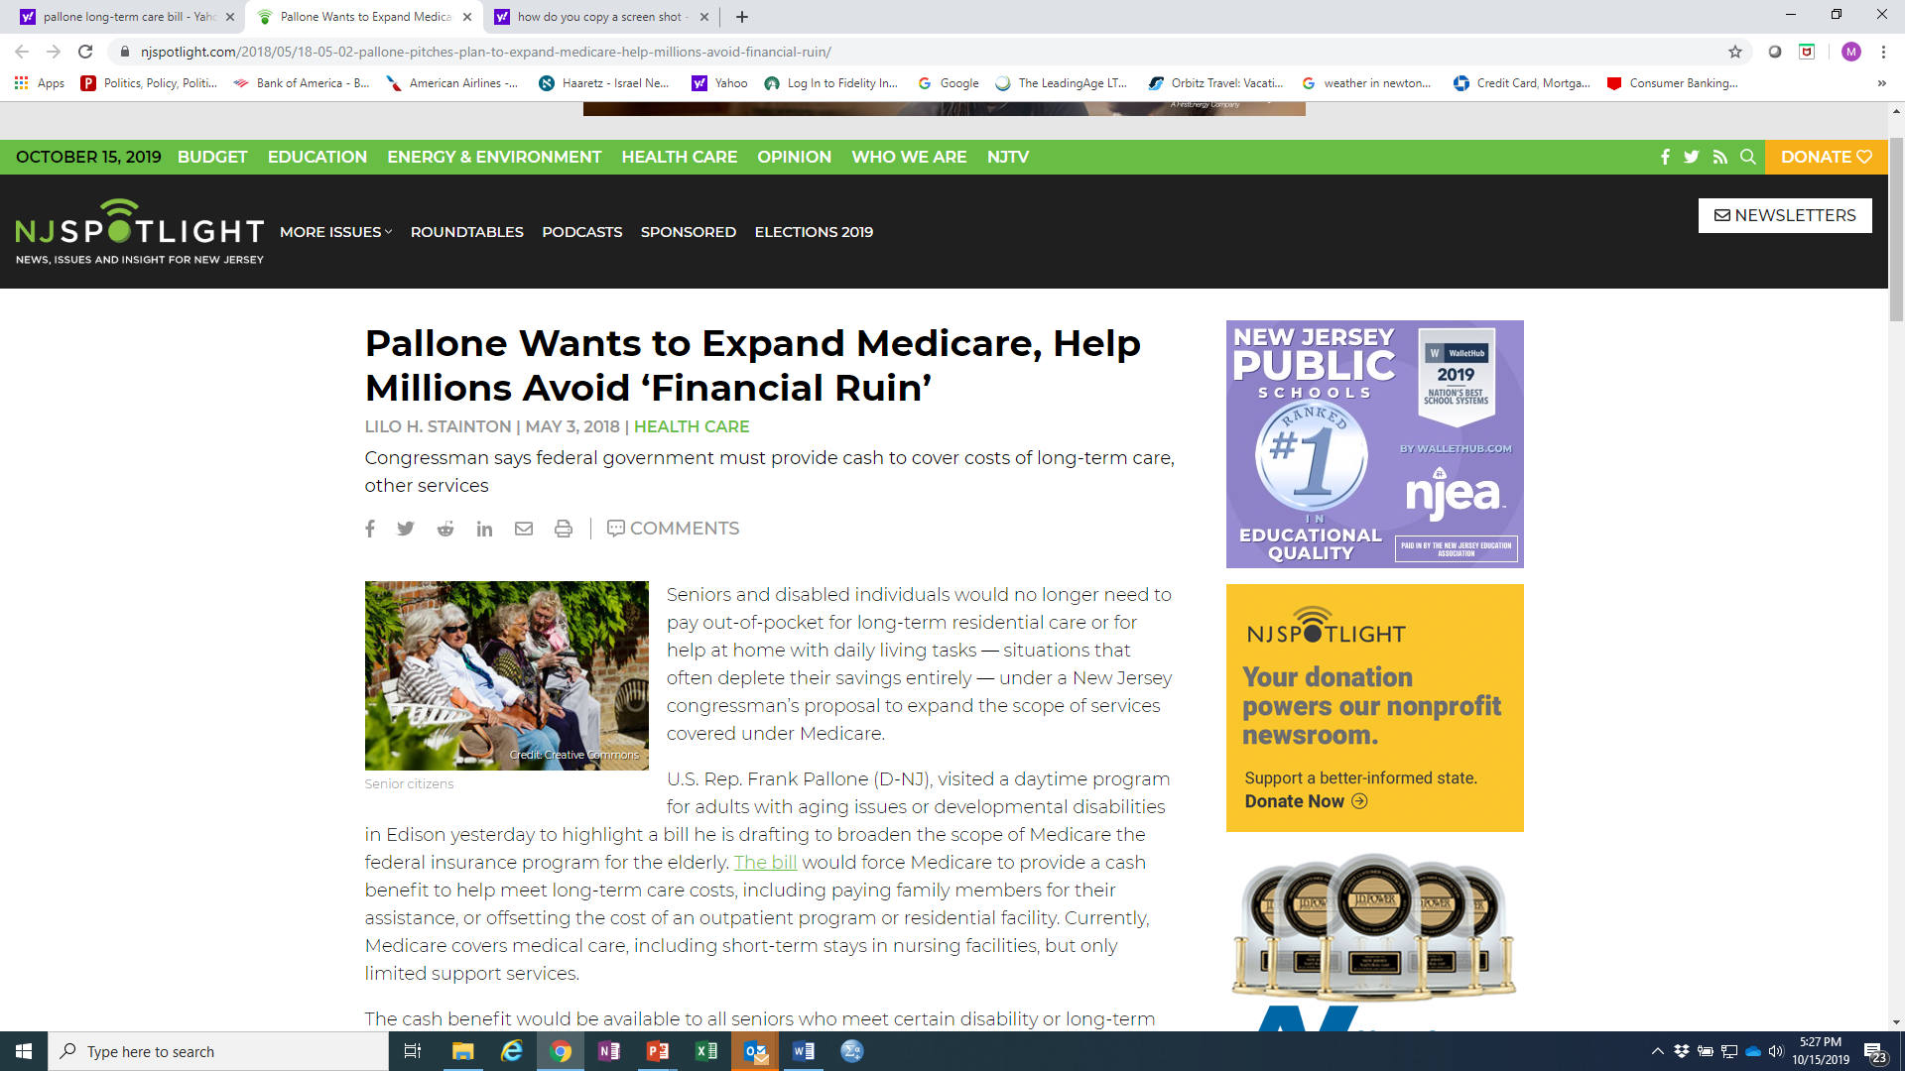
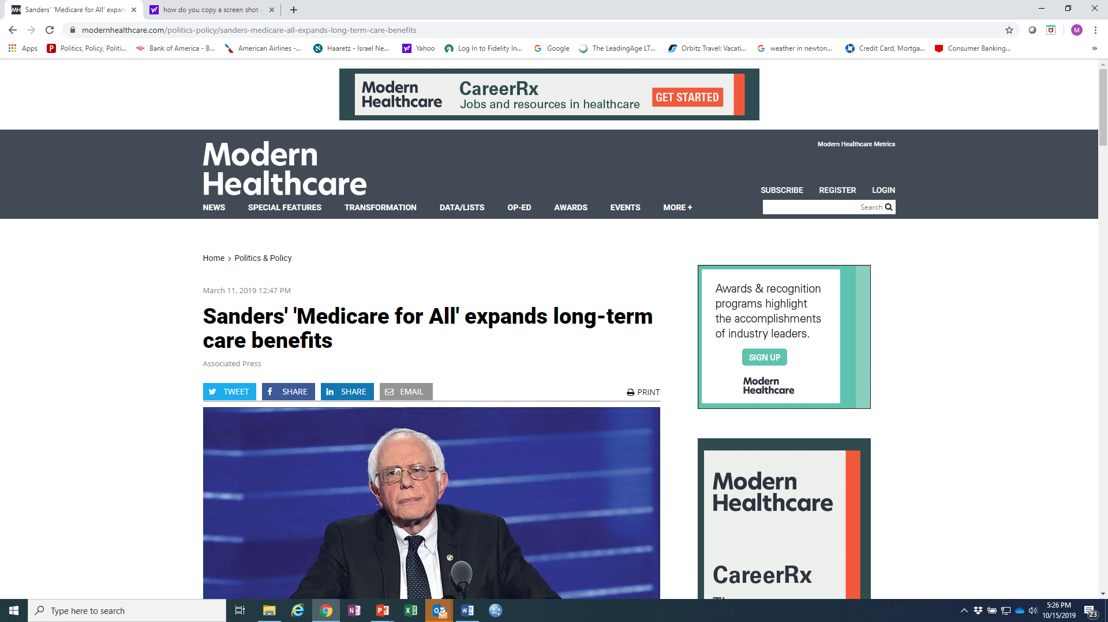
Current Federal Activity:
Proposing Additions to Medicare Coverage
Pallone Bill: Catastrophic Protection plan with Medicare as a chassis
Sanders Medicare for All and also Dingell, Jayapal and more than 100 Co-Sponsors Introduce Medicare For All Act of 2019
Note: A number of think tanks and advocacy groups supportive of catastrophic approach

Slide 31
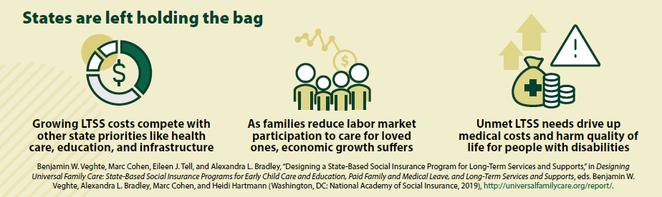
Why are States interested in LTSS reform initiatives?
Limited growth in the private market fueling search for “shared or communal approaches”
Gridlock in policymaking at the federal level does not offer promise.
Changes in family composition lead to strains on budget, workforce & delivery system.
The costs of waiting are starting to exceed the costs of taking action

Slide 32
Do states have expertise to implement new LTSS insurance-based programs?
States are the only level of government with experience administering comprehensive LTSS.
  More than 50 years defining and assessing benefit eligibility, certifying qualified providers, reimbursing providers, and managing benefits
Understand and familiar with the LTSS service delivery system.
States also have a solid track record in launching and running social insurance programs:
  Workers’ compensation and unemployment insurance
  Paid Family and Medical Leave (PFML) social insurance programs (4 states)
Greater political feasibility and ability to reflect unique needs of state residents.

Slide 33
Overcoming the Political Challenges of Reform
The magnitude of the problem means that neither the public nor private sector can address the problem on its own.
  Need mixed approaches where sectoral roles are well defined and enable citizens to plan appropriately.
The “age wave” is already cresting and that means…………….
  Now is the time to experiment with new models of stand-alone financing programs, and
  build on existing service delivery infrastructure to deliver high quality and affordable care to the middle class.
Proof points have been established across a number of states such as Washington, and Hawaii.
Opportunity for change – building a coalition for policy change:
As baby boomers become caregivers and care recipients, they will demand improved access to affordable care.
Allies will include their children and younger people with disabilities who regard independent living support as a civil right.
Allies include direct care workers who regard decent pay & jobs as a worker’s right and to assure a quality workforce.
Policy does not change unless there is a demand for it and coalitions for change are growing.

Slide 34
To what end?
Improving access to LTSS. To what extent does the additional money brought into the LTSS system by the program allow the purchase of additional services?
Reducing family out-of-pocket spending. To what extent does the program relieve financial burdens on families?
Reducing Medicaid spending. To what extent does the program reduce budgetary pressure on Medicaid?
Financial sustainability/stability. Is the program sustainable? Can it to be paid for over the long term in a stable manner?
Political support and sustainability. Is the program structured in a manner that will garner broad public support that is likely to persist over time?

Slide 35
Is this all wishful thinking?
“…Only a crisis—actual or perceived—produces real change. When that crisis occurs, the actions that are taken depend on the ideas that are lying around. That, I believe, is our basic function: to develop alternatives to existing policies, to keep them alive and available until the politically impossible becomes the politically inevitable.”
-- Milton Friedman, Ph.D.
Nobel Economist

Slide 36

CONNECT WITH US

