Slide 1





Medicare Advantage and the CHRONIC Care Act
Implementing Innovative, Nonmedical Solutions for Older Adults
Join the Conversation:
@LTQA
@Daughterhood
@TheSCANFndtn
#MedicareTurningPoint
January 7, 2020

Slide 2
Overview of New Flexibility in MA Supplemental Benefits

Slide 3
What are Seniors’ Options in Medicare?
Medicare Fee-For-Service (FFS) (“Original” Medicare) | Medicare Advantage (MA)
Federal government pays directly for healthcare costs To fill coverage gaps, individuals may choose to buy Supplemental Insurance: Covers co-pays, deductibles, and other non-covered benefits under Medicare | Private insurance companies (HMOs) contract with the federal government to offer “Medicare plans” to older adults In exchange for a flat monthly fee, insurance companies are responsible for all healthcare costs (as provided in plan documents) for people who enroll in their plan Medicare Advantage plans have authority to provide additional supplemental benefits, such as: Preventative care Dental Vision Podiatry Hearing exams and aides

Slide 4










Implementation of the CHRONIC Care Act
Special Supplemental Benefits for the Chronically Ill (SSBCI) were introduced through the CHRONIC Care Act, authorized by Section 50322 of the Bipartisan Budget Act of 2018
The Act allows “…an MA plan [to] provide supplemental benefits to a chronically ill enrollee, that have a reasonable expectation of improving or maintaining the health or overall function of the chronically ill enrollee.”
For the first time in Medicare history, Medicare Advantage plans can now offer nonmedical benefits such as:
 | Meals (beyond a limited basis) |  | Social Needs Benefits
 | Food and Produce |  | Complementary Therapies
 | Transportation for Non-Medical Needs |  | Services Supporting Self-Direction
 | Pest Control |  | Structural Home Modifications
 | Indoor Air Quality Equipment and Services |  | General Supports for Living

Slide 5
MA Plans Can Offer Other Supplemental Benefits
In addition to SSBCI, the Centers for Medicare and Medicaid Services (CMS) also recently expanded the definition of the types of supplemental benefits Medicare Advantage plans can offer.
 | Expansion of Definition of ‘Primarily Health Related’ Supplemental Benefits | Special Supplemental Benefits for the Chronically Ill (SSBCI)
Must be health related? | Yes | No
Examples of Benefits: | • Adult Day Care Services • Home-Based Palliative Care • In-Home Support Services • Support for Caregivers of Enrollees • Medically-Non-Opioid Pain Management • Stand-alone Memory Fitness Benefit • “Home & Bathroom Safety Devices & Modifications” • Transportation • Over-the-Counter Benefits | • Meals • Food and Produce • Transportation for Nonmedical Needs • Pest Control • Indoor Air Quality Equipment and Services • Social Needs Benefits • Complementary Therapies • Services Supporting Self-Direction • Structural Home Modifications • General Supports for Living
How many Medicare Advantage plans are offering these benefits in Calendar Year 2020? (According to CMS press release) | Approximately 500 | Approximately 250
Sources: CMS’ Memo ‘Reinterpretation of “Primarily Health Related” for Supplemental Benefits’ (April 2018) and CMS’ Memo ‘Implementing Supplemental Benefits for Chronically Ill Enrollees’ (April 2019)

Slide 6
Limitations of Using Supplemental Benefits
Limited amount of money:
  Rebate dollars (amount by which the plan bid is less than the CMS benchmark)
  A function of the plan’s quality “star rating” (which adjusts the rebate amount)
  The need to offer universal supplemental benefits (e.g., vision, dental) that have a broad appeal for marketing
Lack of continuity -- supplemental benefits can vary from year-to-year

Slide 7
Challenges of Using Supplemental Benefits
Limited flexibility to build into a care plan
A “benefit” is less flexible than a “clinical program” – has to be universally available to target population
Need to define eligibility and establish a way to determine eligibility
Need to contract for with provider organizations with capacity to serve the service area (lack of prior experience in MA plans)
Challenges in marketing/communicating a targeted benefit.
  Difficult to communicate the eligibility or benefit limits in PlanFinder or plan materials
  Risk of misleading and attracting people to the plan who would not qualify for the benefit

Slide 8
Guiding Principles for New Flexibility Under SSBCI

Slide 9
Who Was Involved in Designing These Principles?
In response to the introduction of these benefits, Anne Tumlinson Innovations (ATI) and the Long-Term Quality Alliance (LTQA), supported by a grant from The SCAN Foundation, convened a working group comprised of a diverse array of national experts on Medicare Advantage and long-term services and supports. The working group consisted of:
Melinda Abrams
Senior Vice President, Delivery System Reform, The Commonwealth Fund
Gretchen Alkema
Vice President of Policy and Communications, The SCAN Foundation
Larry Atkins
Executive Director, National MLTSS Health Plan Association
Howard Bedlin
Vice President, Public Policy and Advocacy, National Council on Aging
Laura Chaise
Vice President, Long Term Services and Supports and Medicare-Medicaid Plans, Centene
Henry Claypool
Policy Director, Community Living Center, UCSF
Marc Cohen
Co-Director, LeadingAge LTSS Center @Umass Boston and Research Director, Center for Consumer Engagement in Health Innovation
* This member joined in their individual capacity
Lindsey Copeland
Federal Policy Director, Medicare Rights Center
Nicole Fallon
Vice President, Health Policy and Integrated Services, LeadingAge
Marty Ford
Senior Advisor, The Arc of the United States
Wendy Fox-Grage*
Senior Strategic Policy Advisor, AARP Public Policy Institute
Danielle Garrett
Strategic Policy Manager, Community Catalyst
Howard Gleckman*
Senior Fellow, Urban Institute
Jennifer Goldberg
Deputy Director, Justice in Aging
Katherine Hayes
Director of Health Policy, Bipartisan Policy Center
Kathy Hempstead
Senior Policy Adviser, Robert Wood Johnson Foundation
Greg Jones
Senior Director, Public Policy, CVS Health, Aetna
Keavney Klein
Senior Counsel, Government Relations, Kaiser Permanente
Tom Kornfield
Vice President, Medicare Policy, AHIP
Jennifer Kowalski
Vice President, Public Policy Institute, Anthem
Christine Aguiar Lynch
Vice President, Medicare and MLTSS Policy, Association for Community Affiliated Plans
Kedar Mate
Chief Innovation and Education Officer, Institute for Healthcare Improvement
James Michel
Director, Policy and Research, Better Medicare Alliance
Cheryl Phillips
President and CEO, SNP Alliance
Ken Preede
Vice President, Government Relations, Commonwealth Care Alliance
Sarah Snyder Rayel
Director, Medicare Policy, Blue Cross
Blue Shield Association
Allison Rizer
Vice President, Policy and Strategy, UnitedHealthcare Community & State
Marisa Scala-Foley
Director, Aging and Disability Business Institute, National Association of Area Agencies on Aging
Nora Super
Senior Director, Center for the Future of Aging, Milken Institute
Lucy Theilheimer
Chief Strategy and Impact Officer, Meals on Wheels America

Slide 10
Why “Principles?”
SSBCI represent a turning point in Medicare policy.
For the first time, Medicare allows coverage of non-primarily health related benefits through the Medicare Advantage program, as well as significant flexibility around who is eligible for these benefits and the services they receive.
We need foundational principles that can inform regulation development, benefit design, and form the basis of a common language for everyone, including:
  CMS and affiliates (OMB, ACL)
  Health plans
  Delivery systems
  Advocates
  Congress and affiliates (GAO, CRS)

Slide 11
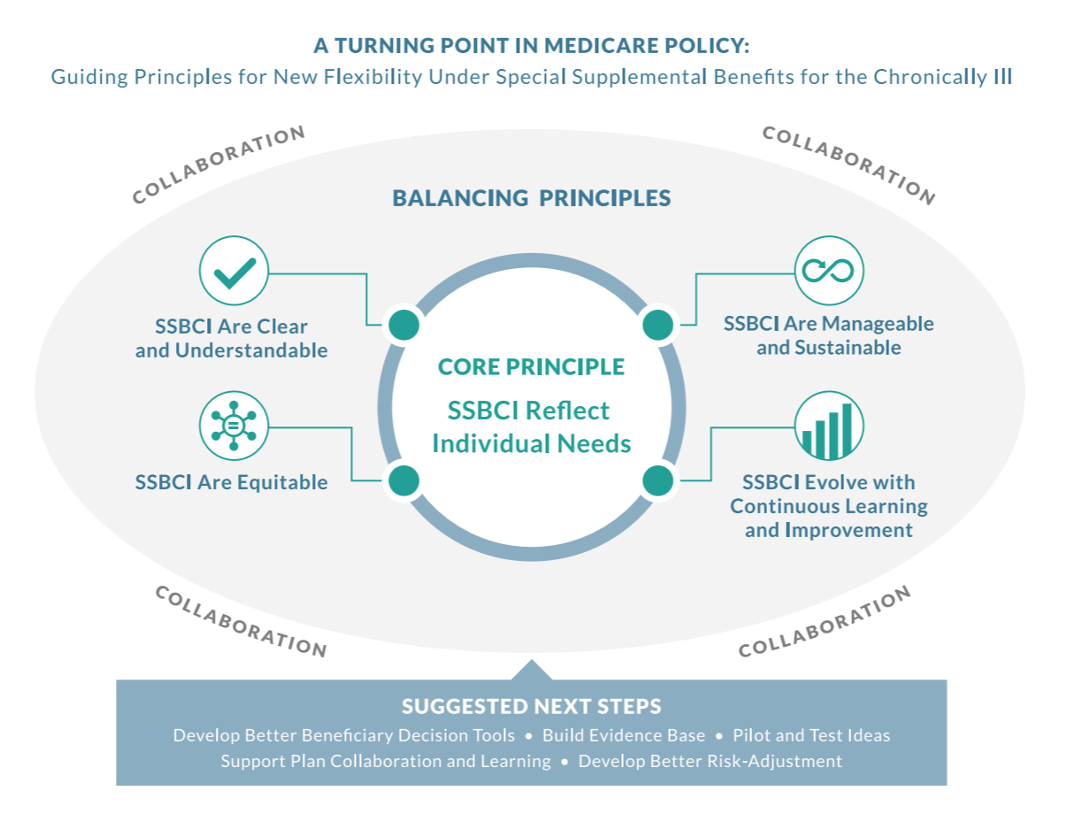
The Guiding Principles

Slide 12




Core Principle and Balancing Principles
Core Principle: SSBCI Reflect Individual Needs | SSBCI flexibility–in benefit flexibility, types of services, and providers–allows for Medicare Advantage plans to meet the individual needs of chronically ill beneficiaries.
Balancing Principle 1: SSBCI Are Clear and Understandable | Key stakeholders, including Medicare beneficiaries and their caregivers, providers, payers, enrollment counselors, and states understand SSBCI as well as its limitations and the circumstances under which they are available.
Balancing Principle 2: SSBCI Are Equitable | Chronically ill Medicare Advantage enrollees receive SSBCI in a consistent, equitable, and nondiscriminatory manner that determines and meets individual need based on chronic illness and functional status.
Balancing Principle 3: SSBCI Are Manageable and Sustainable | Medicare program regulations and guidance, such as rate structures and quality measures, support Medicare Advantage plans in offering, managing, and sustaining their inclusion of SSBCI in MA plan benefit packages.
Balancing Principle 4: SSBCI Evolve with Continuous Learning and Improvement | The federal Department of Health and Human Services (HHS) and CMS, in conjunction with Medicare Advantage plans and other stakeholders, evaluate and measure the extent to which SSBCI are contributing toward meeting the needs of chronically ill enrollees and adapt SSBCI accordingly based on learnings.

Slide 13
Next Steps for the Guiding Principles
Balancing Principle 1: SSBCI Are Clear and Understandable | Develop better beneficiary decision tools and information Increase beneficiary and family caregiver education Raise awareness
Balancing Principle 2: SSBCI Are Equitable
Balancing Principle 3: SSBCI Are Manageable and Sustainable | Develop better risk adjustment
Balancing Principle 4: SSBCI Evolve with Continuous Learning and Improvement | Support plan collaboration and learning Build the evidence base Pilot and test ideas

Slide 14
Implementation of SSBCI

Slide 15
An Early Look at Calendar Year 2020
With the help of the SSBCI Guiding Principles Working Group, Anne Tumlinson Innovations (ATI) and the Long-Term Quality Alliance (LTQA) have engaged in work to understand how these innovative benefits are being offered in the coming year.
A CMS press release stated that approximately 500 plans will be offering new primarily health related supplemental benefits and 250 plans will be offering SSBCI.
500
Plans offering expanded primarily health related supplemental benefits
250
Plans offering brand new nonmedical supplemental benefits
Source: CMS’ Press Release, “Trump Administration Drives Down Medicare Advantage and Part D Premiums for Seniors” (September 2019).

Slide 16
An Early Look of Calendar Year 2020
Early looks at publicly-available data from CMS indicate that 512 plans will be offering at least one of the new supplemental benefits below:
Awaiting January release of publicly-available data showing SSBCI.
New Supplemental Benefit | Number of Plans Offering:
Therapeutic Massage | 242
Adult Day Health Services | 85
Home-Based Palliative Care | 61
In-Home Support Services | 223
Support for Caregivers of Enrollees | 125
Source: Anne Tumlinson Innovations analysis of PBP files.

