Slide 1
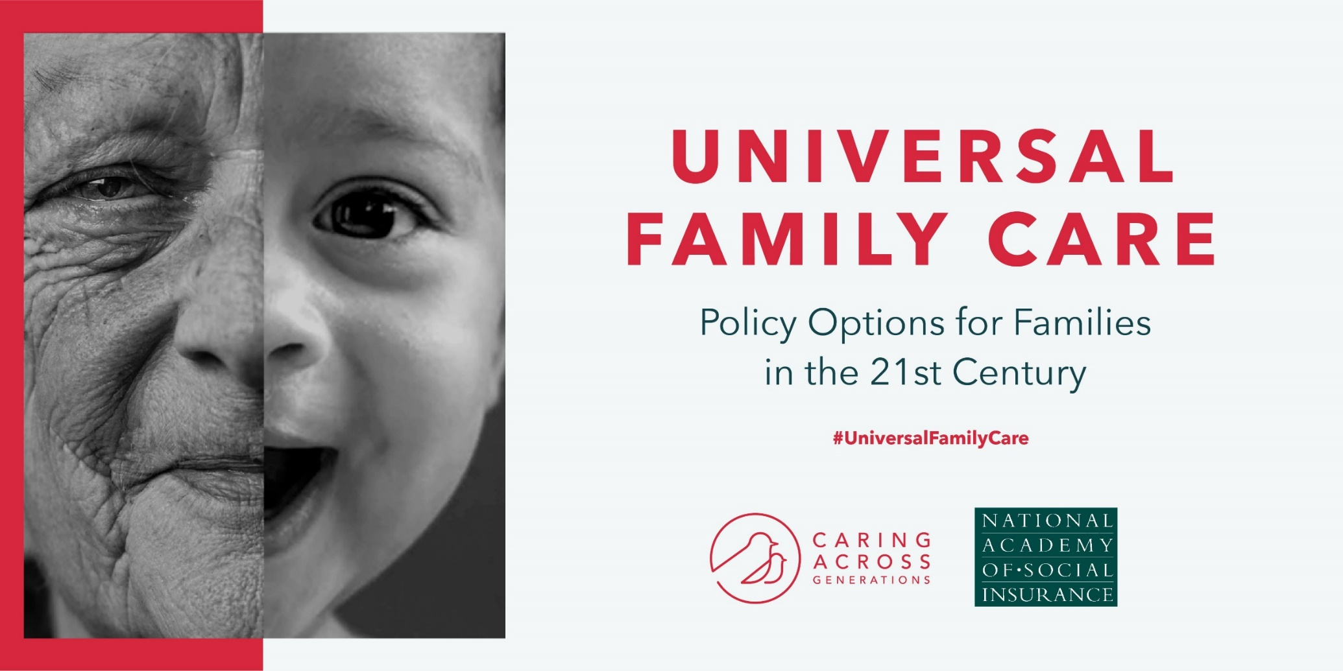
Notes:
Research Director,
Caring Across Generations
Director, Academy Study Panel on Universal Family Care

Slide 2
Caring for loved ones can create some of the most special and meaningful moments of life.
Yet, gaps in our care infrastructure leave many families struggling to both work and provide care.

Slide 3
Why has the care risk become salient now?
Today’s families need all adults’ earnings to make ends meet
A national shortage of elder caregivers is approaching
Care costs are out of reach for many
64%
7:1 3:1
$50,336
of mothers bring in at least one quarter of family earnings; 41% bring in half or more.
– Center for American Progress
is the projected decline between 2015 and 2050 in the ratio of people aged 45-64 to each person 80+.
– AARP
is the annual cost for a Home Health Aide, while the average cost of childcare ages 0-4 is nearly $10,000 .
– Genworth; New America

Slide 4
CCDBG
FMLA
A patchwork of disparate programs leaves many of us with costly bills and anxieties about caring for our loved ones - at every stage of life, and growing older ourselves.
CCRC
Medicaid HCBS waivers
Paid leave
Head Start
Medicaid nursing facility services

Slide 5
The number of paid caregivers won’t meet demand, and care jobs are poorly compensated, limiting the quality and growth of the care workforce and the quality of care.

Slide 6
Families bear the burden of care.
And an increasing number of us are “sandwiched” between caring for both our children and our parents.

Slide 7
But improving our care infrastructure is possible.
Long-term services and supports, paid family and medical leave, and early childcare and education are insurable risks.
Our families experience these needs and risks as interconnected.
There are synergies to addressing them together.
And states have an important role to play.

Slide 8
Academy Study Panel Overview
Task
Purpose
Timeline
People
Design policy options for state-based social insurance programs for Early Childcare and Education (ECCE), Paid Family and Medical Leave (PFML), Long-Term Services and Supports (LTSS), and Universal Family Care (UFC)
01 Create roadmap for
state policymakers
considering social
insurance programs
02 Highlight implications
and tradeoffs for
key decision points
related to:
a. Structure
b. Financing
c. Integration
d. Implementation
December 2017 through June 2019
Funded by the Ford Foundation and Caring Across Generations
01 Panel Co-Chairs:
Marc Cohen and
Heidi Hartmann
02 Panel Members:
29 experts in three
working groups
03 Project Staff:
Benjamin Veghte
(Project Director),
Alexandra Bradley

Slide 9
ECCE/PFML Working Group Members
LTSS Working Group Members
Heidi Hartmann, Working Group Chair; President and CEO, Institute for Women’s Policy Research; Economist in Residence, American University; MacArthur Fellow
Indivar Dutta-Gupta, Co-Executive Director, Economic Security and Opportunity Initiative, Georgetown Center on Poverty and Inequality
Kathryn Edwards, Associate Economist, RAND Corporation; Professor, Pardee RAND Graduate School
Joan Entmacher, Senior Fellow, National Academy of Social Insurance
Jocelyn Frye, Senior Fellow, Center for American Progress
Jeffrey Hayes, Program Director, Job Quality and Income Security, Institute for Women’s Policy Research
Elaine Maag, Principal Research Associate, Urban-Brookings Tax Policy Center, The Urban Institute
Aparna Mathur, Resident Scholar, Economic Policy, American Enterprise Institute; Co-Director, AEI-Brookings Project on Paid Family and Medical Leave
Michelle McCready, Chief of Policy, Child Care Aware of America
Ray Pepin, Temporary Disability Insurance (TDI) Administrator, Rhode Island Department of Labor & Training
Erik Rettig, Senior Manager, SMB/Economic Policy, Intuit
Christopher Ruhm, Professor of Public Policy and Economics, University of Virginia
Marci Ybarra, Associate Professor, School of Social Service Administration, University of Chicago
Marc Cohen, Working Group Chair; Co-Chair, Professor, McCormack Graduate School of Policy and Global Studies, University of Massachusetts, Boston
Eddie Armentrout, Consulting Actuary, Actuarial Research Corporation
Brian Burwell, VP, Health Policy and Data Analytics, IBM Watson Health
Henry Claypool, Policy Director, Community Living Policy Center, UCSF
Robert Espinoza, VP of Policy, PHI
Judith Feder, Professor of Public Policy, McCourt School of Public Policy, Georgetown
Howard Gleckman, Senior Fellow, The Urban Institute
David Grabowski, Professor of Health Care Policy, Harvard Med School
Michael Miller, Director, Strategic Policy, Community Catalyst
Rebecca Owen, Consulting Actuary, HealthCare Analytical Solutions, Inc.
Heinz Rothgang, Professor of Health Economics, SOCIUM Research Center on Inequality and Social Policy, University of Bremen
Allen Schmitz, Principal and Consulting Actuary, Milliman, Inc.
Mary Sowers, Executive Director, National Association of State Directors of Developmental Disabilities Services (NASDDDS)
David Stevenson, Professor, Health Policy, Vanderbilt University Medical Center
Eileen J. Tell, President and CEO, ET Consulting, LLC
Anne Tumlinson, CEO, Anne Tumlinson Innovations ,LLC

Slide 10
Early Childcare and Education

Slide 11
The Case for Investing in Universal Childcare & Education
Existing patchwork of programs inadequate
Only very low-income families eligible
Eligibility requirements strict and confusing
Significant ROI from expanded access
High developmental value for children
Allows parents to stay in the workforce
Develops our future workers, citizens, communities
Universal program would improve equity and access to care
Could address today’s quality disparities (by income) and access disparities (by region)
Focus on diversity + cultural competence could lessen gaps in achievement/socio-emotional development
Nonstandard hours could make care meaningful to more working parents

Slide 12
Policy Options for States - ECCE
Comprehensive universal program
All children eligible
Essentially an expansion of existing public education
High up-front public investment
Employment-based contributory program
Targets resources specifically to working families
Coverage is not universal – expanded coverage would require additional provisions
Determining eligibility could be administratively challenging
Universal subsidy program
All children eligible
May or may not cover full cost of care, or even a sufficient amount, depending on the generosity of the program
Greater flexibility for state and families

Slide 13
Tradeoffs of ECCE Policy Options
Universal programs better positioned to improve equity in child development outcomes than employment-based ones
Employment-based approach leaves many children out while shifting others in and out of coverage
Benefit adequacy (share of cost subsidized) critical
If family share of cost after public subsidy exceeds affordability threshold for low-income households, an ECCE program could exacerbate inequality

Slide 14
Paid Family and Medical Leave

Slide 15
Context and Considerations - PFML
Landscape of Existing State Programs
5 states have long-standing temporary disability insurance (TDI) programs
California, New Jersey, Rhode Island, New York, Hawaii
4 of the above states have added paid family leave to their existing TDI programs
California, New Jersey, Rhode Island, New York
5 additional states are in the process of implementing new PFML programs
District of Columbia, Washington, Massachusetts, Connecticut, Oregon

Slide 16
State Decision Points
Structural design. How is the program designed and who is responsible for managing different aspects?
Financing. Who pays and how are revenues collected?
Qualifying events. What triggers eligibility? Who can you take paid leave for, and/or who counts as family?
Eligibility requirements. What work history and/or earnings requirements do you need to meet to be eligible?
Benefits. How much time can you take off to provide or receive care? How much will you be compensated for? Are workers guaranteed the right to return to their jobs?

Slide 17
Policy Options for States - PFML
Contributory social insurance
Simplifies administration
Spreads risk most broadly
Reduces potential discrimination
Hybrid social insurance with regulated private options or only private
Higher administrative complexity than exclusive state fund
Increases employer choice
Requires robust regulatory mechanisms

Slide 18
Minnesota’s Paid Family & Medical Leave Act would:
Provide up to 12 weeks of paid medical leave (incl. pregnancy)
Provide up to 12 weeks of paid family leave
Provide partial wage replacement on a progressive scale up to 100% of statewide AWW (~$1100 in 2019)
Protect job and healthcare benefits during leave
Leverage social insurance design to create statewide risk pool
Share costs between workers and their employers
Allow employers to offer comparable plan
Build on Minnesota’s UI administration

Slide 19
Long-Term Services and Supports

Slide 20
Key Decision Points Program Design
Why social insurance approach?
Eligible population
Generational transition issues
Timing and duration of coverage
First dollar (front-end coverage)
Catastrophic Coverage (back-end)
Comprehensive coverage
Benefit eligibility criteria
Level of benefit payment
Form of benefit (cash-service reimbursement continuum)

Slide 21
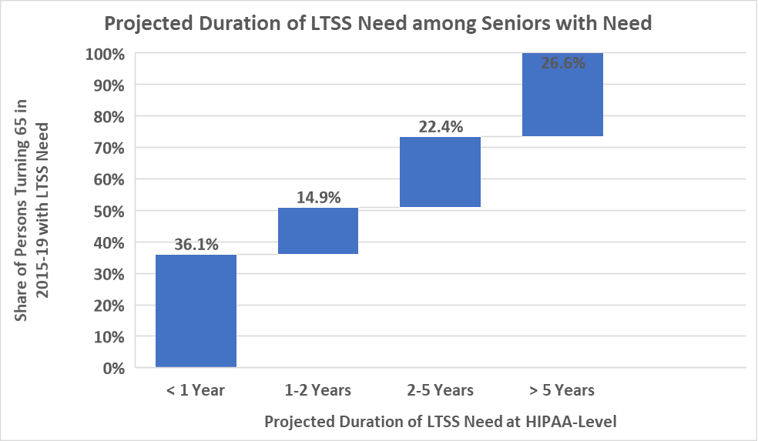
Who Would Benefit from Alternative Coverage Durations and Start Times?
Source: Melissa Favreault and Judith Dey, “Long-Term Services and Supports for Older Americans: Risks and Financing Research Brief,” Office of the Assistant Secretary for Planning and Evaluation, U.S. Department of Health and Human Services, Washington, D.C., February, 2016,

Slide 22
Financing Sources and Considerations
Sources
Existing Federal Social Insurance Programs
Social Security
Medicare Part A
Medicare Parts B and D
Medicare net investment income tax
Existing State Social Insurance Programs
Workers compensation
Unemployment insurance
Paid family and medical leave
Additional Potential Funding Approaches
Taxes
Fees
Premiums
Considerations
Pay As You Go vs. Pre-Funding
Size of tax base
Fiscal sustainability
Political sustainability
Affordability
Connection with program benefits
Using more than one funding source

Slide 23
Payment & Delivery System Integration
Coordination of benefits with other payers
Who is second payer?
Coordination of benefits with private insurance
Federal Medicaid funding issues
How to assure no loss of Federal Matching
Are program benefits considered income?
Integration of LTSS and medical care
How to integrate with coordinated delivery systems?

Slide 24
Ultimate Goals
Improving access to LTSS. To what extent does the additional money brought into the LTSS system allow the purchase of additional services?
Reducing family out-of-pocket spending. To what extent does the program provide financial relief?
Reducing Medicaid spending. To what extent does the program reduce budgetary pressure on Medicaid?
Financial sustainability/stability. Can the program be paid for over the long term in a stable manner?
Political support and sustainability. Is the program structured in a way that will garner broad public support, likely to persist over time?

Slide 25
Universal Family Care
An Integrated Approach

Slide 26
Universal Family Care would be a new social insurance program to which everyone would contribute while they are working, and from which everyone would benefit.

Slide 27
Universal Family Care Insures for 3 Care Needs

Slide 28
The case for an integrated, universal approach
We all juggle work and care
Not just those with low income
More efficient way to pay for care
Families pay a little from each paycheck rather than a lot during time of crisis
More family friendly
Allows families to focus on one other during care episodes
One stop shop
Less red tape for families and states due to single access point, lack of means testing

Slide 29
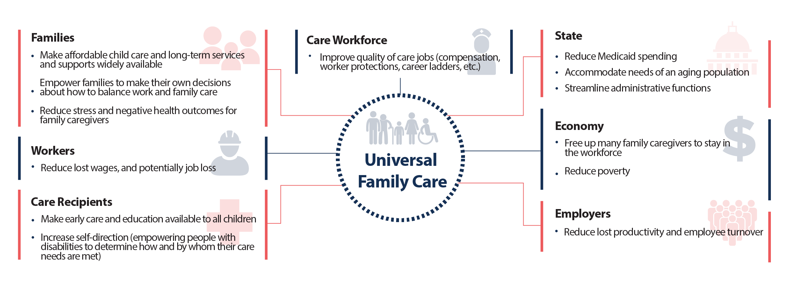
How Could UFC Benefit Society?

Slide 31
As Leah begins to explore her options, UFC offers her an integrated approach to care supports grounded in her specific family care situation:
First, it asks what she needs. Then, it suggests a personalized set of supports she may be eligible for.

Slide 32
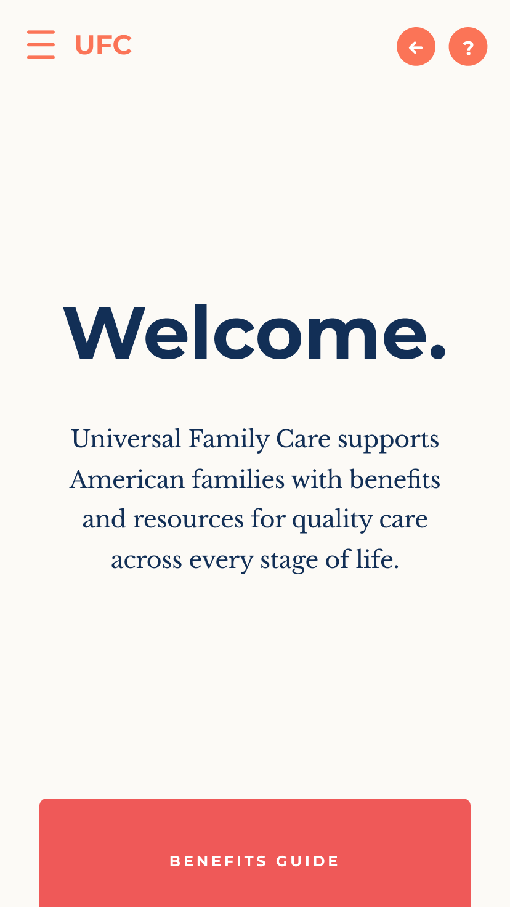

Slide 33
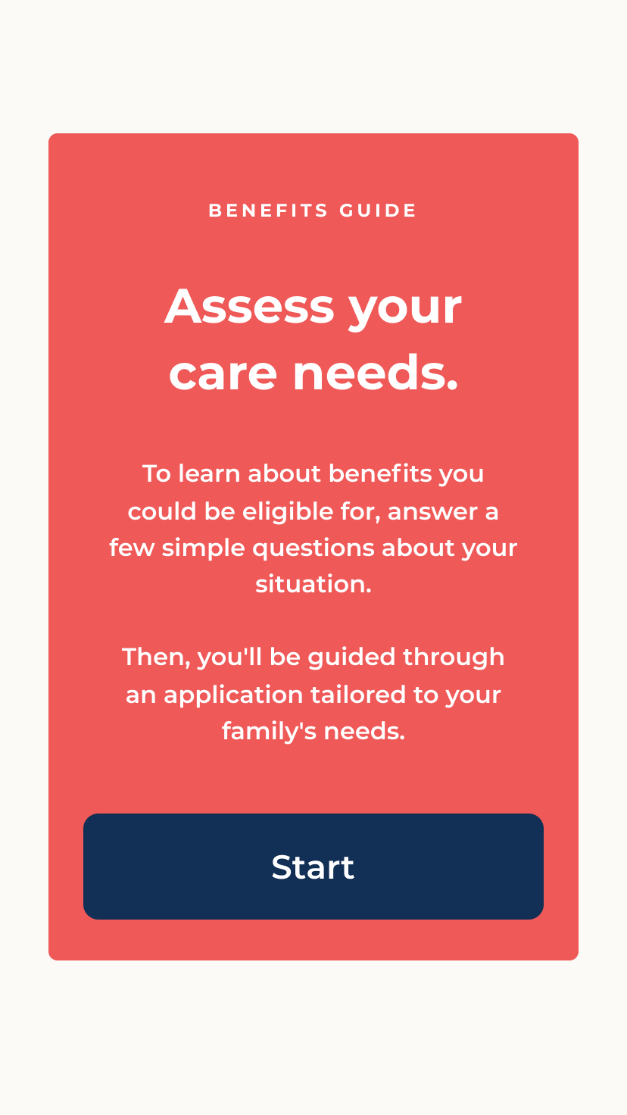

Slide 34
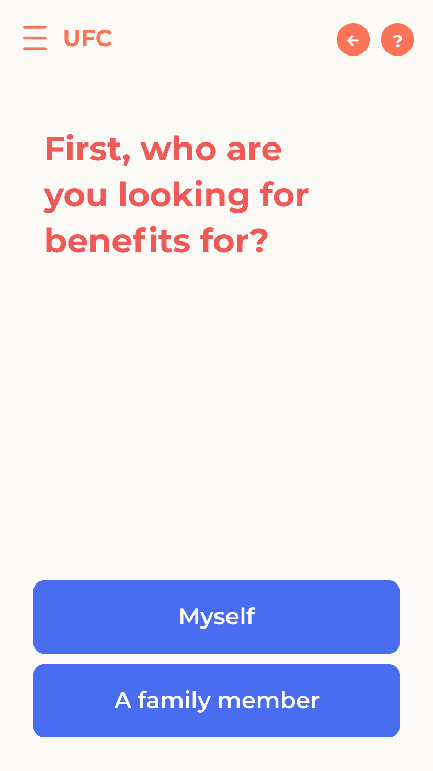

Slide 35
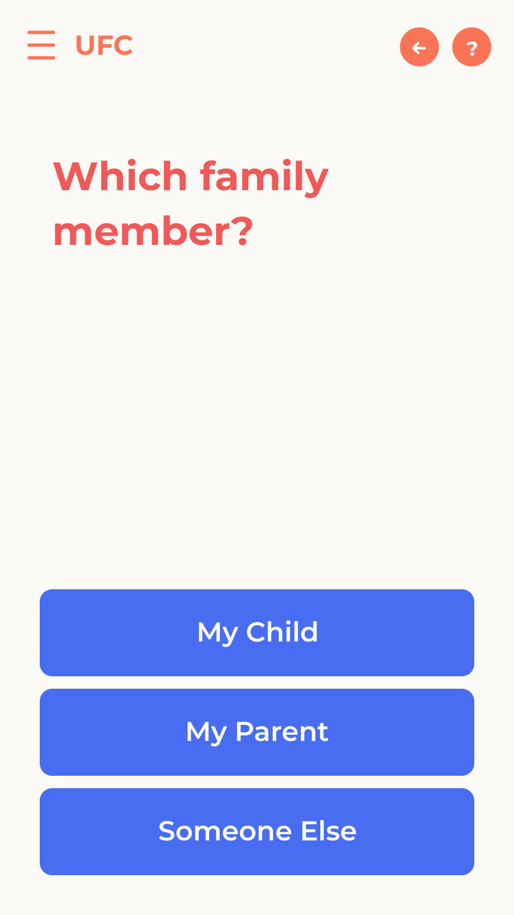

Slide 36
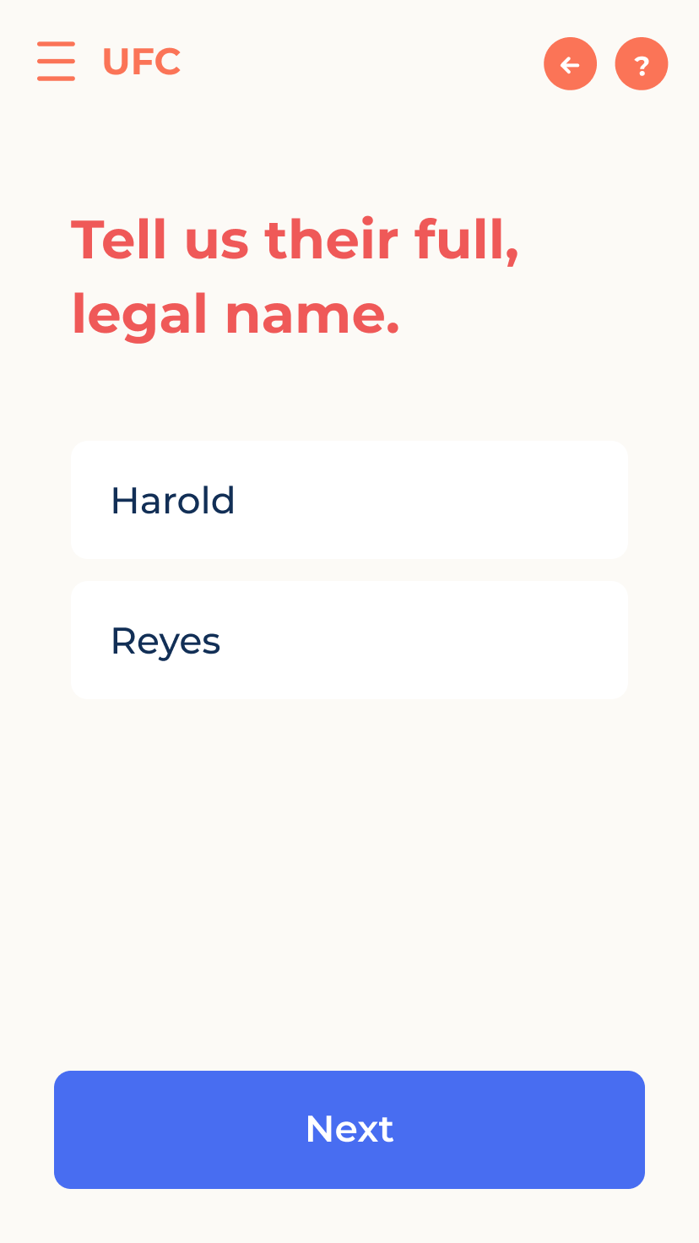

Slide 38
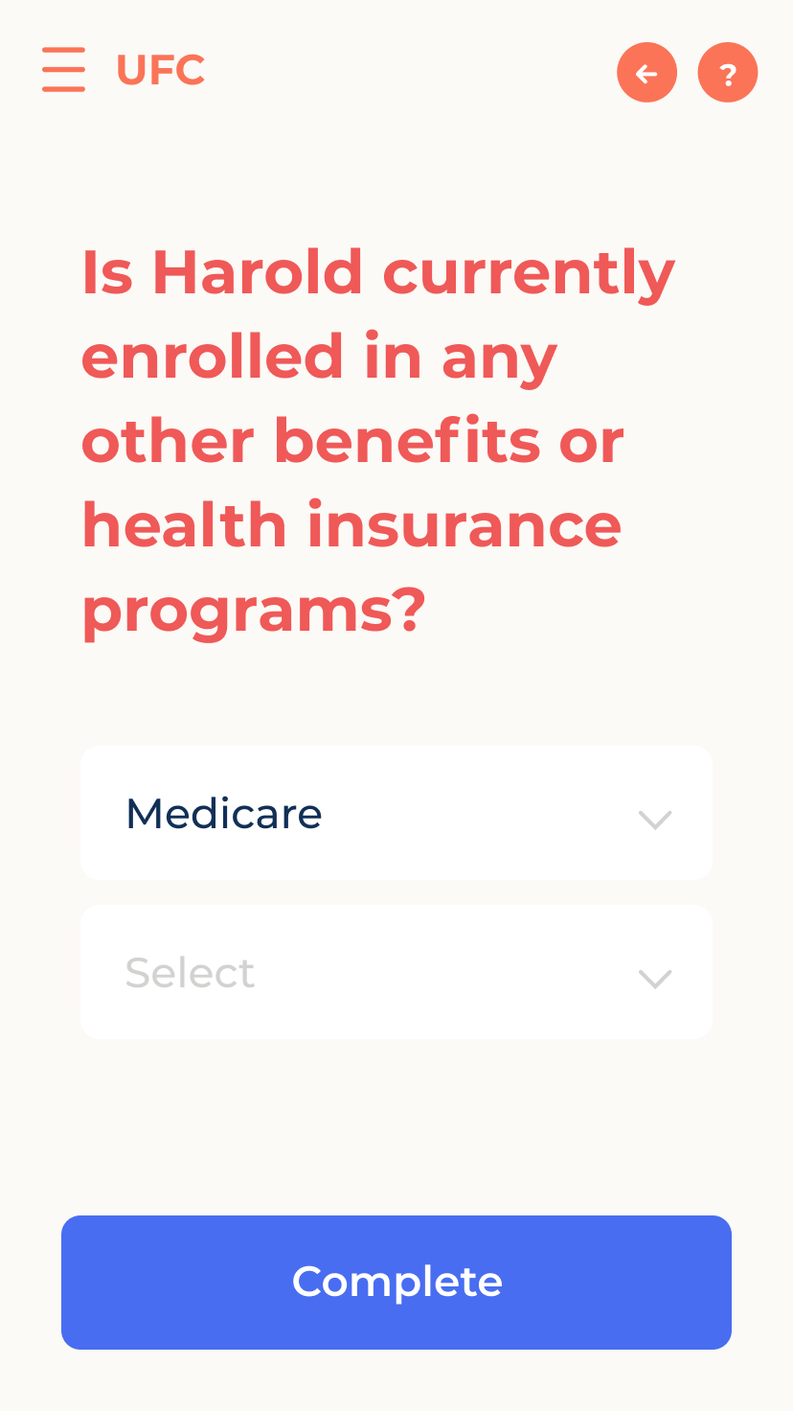

Slide 39
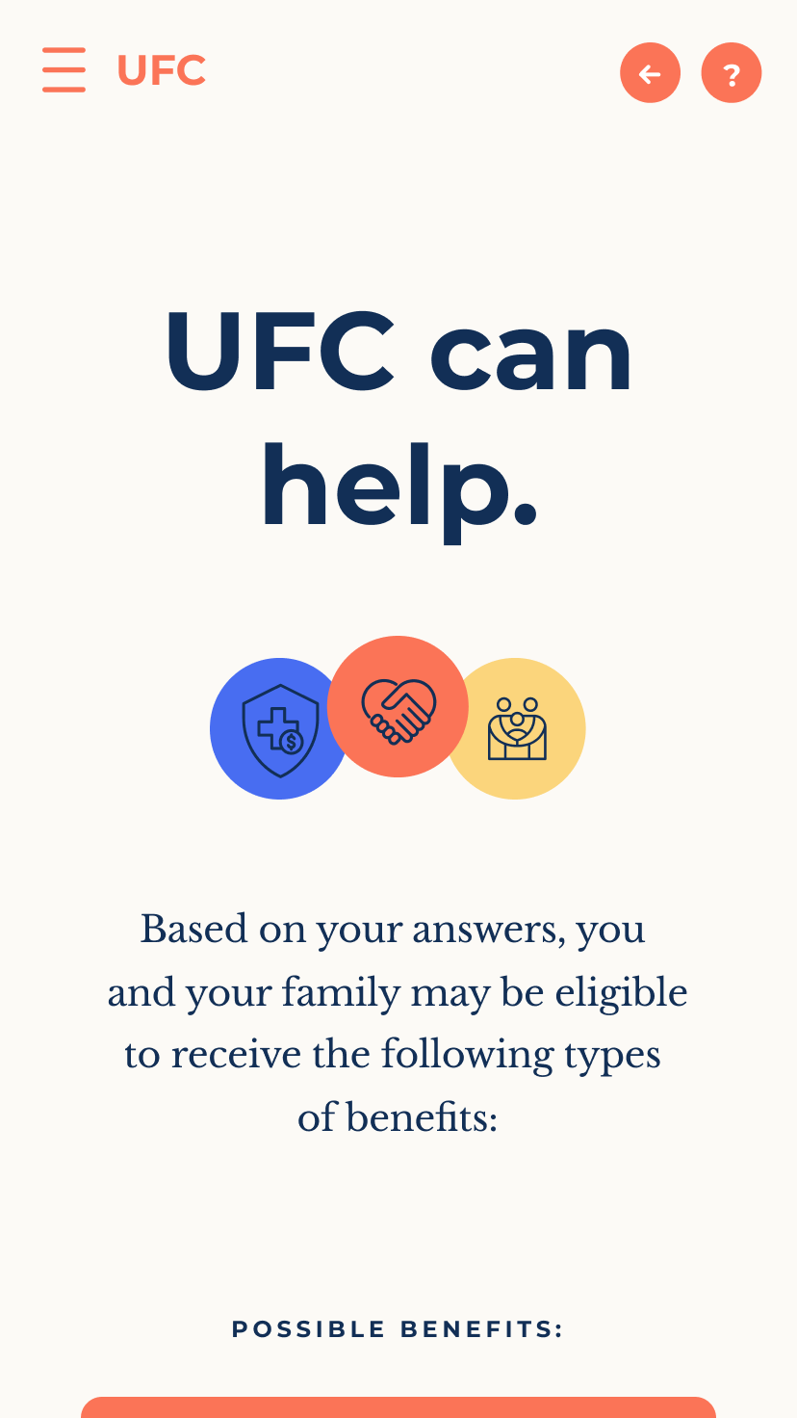

Slide 40
Over the course of Leah’s lifetime, there will be multiple moments when she might need Universal Family Care...
In each of these moments, UFC offers Leah guidance, resources, and relief she needs to care for her family. Let’s take a look at how she manages her UFC dashboard.

Slide 42
Pillars of a Universal Family Care program
Work is the foundation
Everyone who is working contributes and the program enables people to work
Flexible and portable
Covers people across jobs, including 1099 income, across the life course as needs change
Single access point for variety of supports
Supports change as care needs change
Invests in care workforce
Compensation, labor protections, career ladders

Slide 43
UFC Design Elements and Considerations
Two structural approaches:
Contributory social insurance approach
Comprehensive approach

Slide 44
What Level of Financing Would be Required?
Preliminary ballpark estimate:
UFC Program | Social Security Payroll Tax Rate | Income Tax Rate | Medicare Tax |  | Medicare Tax
 |  |  | (if payroll tax only) |  | (if payroll & investment income tax)
 |  |  | Payroll tax rate | Additional rate on earnings > $200k/$250k | Payroll tax rate | Additional rate on earnings > $200k/$250k | Investment income tax rate
ECCE: NAS Illustrative Package | 2.02% | 1.48% | 1.55% | 0.66% | 1.44% | 0.61% | 2.56%
PFML: Family Act
LTSS: Front-End Coverage

Slide 45
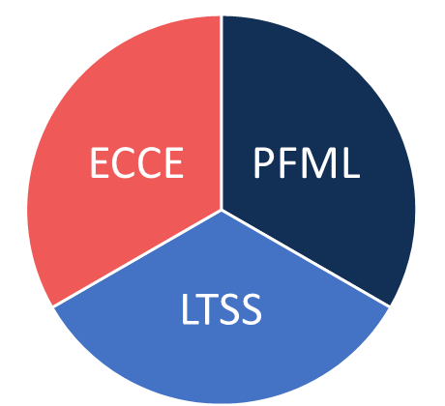
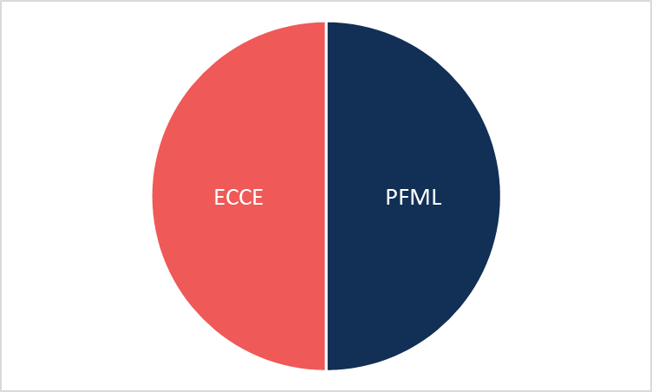
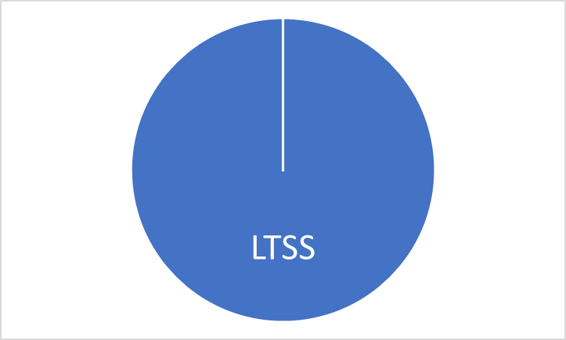
Financial Integration
Highly integrated: One care insurance fund
Moderately integrated: Two funds
ECCE/PFML: 1-2 Year Horizon LTSS: 75 Year Horizon

