Slide 1






WHO we are and
WHAT we do…
Understanding individual effects and susceptibility
EXPOSURE SCIENCE
INFECTIOUS DISEASES
OCCUPATIONAL HEALTH
TOXICOLOGY
CLIMATE CHANGE
FOOD SAFETY
INJURY AND VIOLENCE
EPIDEMIOLOGY AND PREVENTION
VISION
A world in which environmental justice and health equity prevail.
MISSION
The Division of Environmental Health Sciences improves the health of individuals and communities by conducting rigorous and collaborative research to identify risks, reduce hazards, and inform public health policies, and by providing outstanding interdisciplinary education to prepare future environmental health practitioners and leaders.
Assessing environmental exposures
Understanding effects on communities and populations
Informing and evaluating policies and practices, community empowerment, health and wellness equity
Division of Environmental Health Sciences (EnHS)

Slide 2


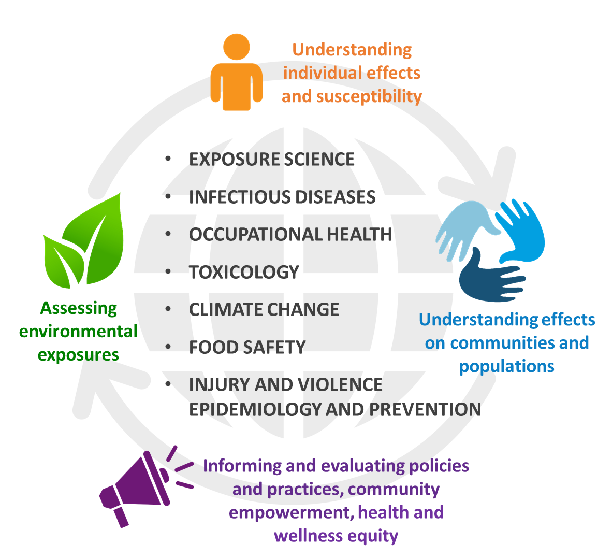






WHO we are and WHAT we do…
Drought and Occupational Psychosocial Stress among
Farmers [J. Berman]
Great Plains Center for Agricultural Health
Extreme weather is a growing health threat, but the impacts from drought are poorly understood. We found drought to be a risk factor for increased work-related mental stress among Midwest farmers. Our work will inform drought early warning plans.
Examples of projects
Prevalence of SARS-CoV-2 antibodies in MN Grocery Store Workers
[C. Hedberg]
Minnesota Department of Health
This study established prevalence estimates for SARS-CoV-2 seropositive status among MN grocery store workers and will measure vaccine status, attitudes, and uptake among this group of essential workers.
Effect of the microbiome upon
deer tick range expansion in
the Upper Midwest [J. Oliver]
MN Futures
Deer tick range expansion and pathogen infection is driven by environmental conditions and internal microbiotic factors. We are working to discover how these factors and drive colonization of new territories by ticks, pathogen infection of ticks, and transmission of tick-borne diseases.
Link for Equity [M. Ramirez]
National Institute of Minority Health and Disparities
This study evaluates the effect of Link for Equity, a culturally responsive trauma-informed care intervention designed to reduce the impacts of childhood adversities, including from racism and community violence, and reduce violence disparities among youth of color.
Division of Environmental Health Sciences (EnHS)

Slide 3

WHO we are and WHAT we do…
PROJECT IMPACT KEY:
Metrics, Outbreak Evaluation, Scholarships and Integrated Food Safety Centers of Excellence (CoE) Activities [C. Hedberg]
MDH (CDC prime) / H1201-3000068209
The CoE serve as resources for public health professionals who conduct surveillance for food-borne illnesses and investigate outbreaks. The CoE develop tools, deliver trainings, and evaluate the effectiveness of outbreak investigations to strengthen efforts to prevent future illnesses and outbreaks.
The DNA adductome of lung carcinogenesis [S. Balbo]
NIH/NCI R01CA220376
This study uses state of the art high resolution mass spectrometry DNA adductomic techniques to structurally characterize the DNA damage in the lung carcinogenic process. The results from this study will help to identify more effective preventive, therapeutic and diagnostic strategies for lung cancer.
Drought and Occupational Psychosocial Stress among
Farmers [J. Berman]
Great Plains Center for Agricultural Health
Extreme weather is a growing health threat, but the impacts from drought are poorly understood. We found drought to be a risk factor for increased work-related mental stress among Midwest farmers. Our work will inform drought early warning plans.
Individuals
Community
Environment
Policies
Evaluation of Drought Indicators
for Improved Public Health
Decision Making [J. Berman]
NOAA CPC
Developing hazard messaging and response plans require reliable information. Our focus is to evaluate drought indices with various health outcomes to identify discrepancies in risk and inform regional risk management plans.
Evaluation of Health Department Restaurant Inspection Programs
[C. Hedberg]
NEHA (CDC prime); U38OT000300-01-01
This project evaluated restaurant inspection programs, identifying public posting of inspection results at the point of service as a best practice that can improve food safety.
Air Pollution and Violent
Behavior [J. Berman]
Violence is a leading cause of death and injury, but environmental causes of violence are poorly understood. In a large national study, we identified that air pollution is linked to increased violent criminal behavior.
Division of Environmental Health Sciences (EnHS)

Slide 4
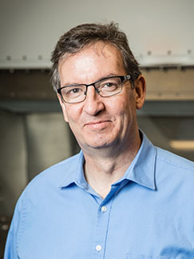
WHO we are and WHAT we do…
PROJECT IMPACT KEY:
Prevalence of SARS-CoV-2
antibodies in MN Grocery Store Workers [C. Hedberg]
Minnesota Department of Health
This study established prevalence estimates for SARS-CoV-2 seropositive status among MN grocery store workers and will measure vaccine status, attitudes, and uptake among this group of essential workers.
Link for Equity [M. Ramirez]
National Institute of Minority Health
and Disparities
This study evaluates the effect of Link for Equity, a culturally responsive trauma-informed care intervention designed to reduce the impacts of childhood adversities, including from racism and community violence, and reduce violence disparities among youth of color.
Firearm Violence [M. Ramirez]
Office of Academic Clinical Affairs (OACA)
This longitudinal study follows Minnesota children from early childhood through adulthood to identify the individual and environmental factors that predict involvement in firearm violence perpetration.
Individuals
Community
Environment
Policies
Optimizing Assessment of Virus-Containing Particles in Animal Agriculture [P. Raynor]
NIOSH / U54OH010170
The objectives of this research are to develop a high-volume, field-portable, size-differentiating viral aerosol sampler and use it to measure worker exposures to viable airborne influenza viruses in animal agriculture facilities. With accurate measurements, we can assess ways to minimize exposures.
Effect of the microbiome upon
deer tick range expansion in the Upper Midwest [J. Oliver]
MN Futures
Deer tick range expansion and pathogen infection is driven by environmental conditions and internal microbiotic factors. We are working to discover how these factors and drive colonization of new territories by ticks, pathogen infection of ticks, and transmission of tick-borne diseases.
Effectiveness of Anti-bullying
Laws [M. Ramirez]
CDC -National Center for Injury
Control and Prevention
This study assesses the implementation and impacts of anti-bullying laws on reducing youth violent behaviors, including bullying and fights in schools. The study involves close collaboration with the Maine Department of Education.
Division of Environmental Health Sciences (EnHS)

Slide 5






WHO we are and WHAT we do…
PROJECT IMPACT KEY:
Evaluating a Pandemic’s Impact
on Gig-Workers: How Is Health
and Well-Being Affected by
COVID-19? [P. Raynor]
NIOSH / T42OH008434 (to E. Avila)
This research seeks to identify health and safety perceptions among gig-workers, and determine the impact COVID-19 has had on gig-workers’ well-being.
Promoting Safety and Worker Health for Immigrant Dairy
Workers [J. Bender]
CDC-NIOSH (3U54OH010170-07S1)
The goal of this project is to improve the occupational health and safety of Minnesota’s growing immigrant dairy workforce through a train-the-trainer and a community health worker (CHW) model. This involves incorporating a One Health approach, employing a multidisciplinary team of clinicians, veterinarians, producers, workers and community health centers.
Minnesota HHEAR Targeted Analysis Laboratory [L. Peterson]
NIEHS / U2CES026533
This program brings together experts from the University of Minnesota and the Minnesota Department of Health to provide a national resource for exploring environmental, lifestyle, and related factors that can affect human health. The outcomes of projects conducted through HHEAR will lead to more effective disease prevention strategies.
Individuals
Community
Environment
Policies
Surveillance and Investigation of SARS-CoV-2 in Animals,
Minnesota [J. Bender]
CDC-CSTE
The focus of this study is the creation of a timely surveillance system to detect SARS-CoV-2 in companion animals, shelter animals, and wildlife.
Stress Tolerance in Campylobacter and its Impact on Food Safety
[B. Jeon]
Campylobacter is the leading foodborne pathogen in the U.S. Our laboratory investigates the mechanisms for Campylobacter survival under stress conditions during food processing and its effect on food safety and public health.
Division of Environmental Health Sciences (EnHS)

Slide 6

WHO we are and WHAT we do…
PROJECT IMPACT KEY:
Food Safety Interventions to Control Listeria Biofilm [B. Jeon]
Healthy Foods, Healthy Lives Institute
Listeria monocytogenes is the foodborne pathogen showing the highest rates of case
fatality and hospitalization in the U.S. This project aims to address food safety issues associated with Listeria biofilms using phylogenetic, epidemiological, and molecular microbiological approaches.
Individuals
Community
Environment
Policies
Antibiotic Alternatives to Control Resistant Pathogens [B. Jeon]
Widespread antibiotic-resistant pathogens significantly compromised the efficacy of existing antimicrobial therapies. This project aims to develop new antimicrobial therapeutic approaches using antimicrobial synergy with natural phytocompounds and bacteriophages, which are bacteria-infecting viruses.
Division of Environmental Health Sciences (EnHS)

Slide 7
WHO we are and WHAT we do…
PROJECT IMPACT KEY:
Individuals
Community
Environment
Policies
TITLE
Sponsor/Grant number
Short summary or abstract of the research project and/or outcomes.
Division of Environmental Health Sciences (EnHS)

Slide 8





How do we collaborate?
Forming collaborations and partnerships across the University, and impacting local, state, regional, national and global communities.
EnHS faculty play major roles in many centers and institutes within our division, and across the University.
STATE AND REGIONAL
NATIONAL AND GLOBAL
Centers housed in the Division of Environmental Health Sciences
Exposure Science and Sustainability Institute (ESSI)
Midwest Consortium for Hazardous Waste Worker Training
Midwest Occupational Health and Safety Education and Research Center (MCOHS)
Minnesota Food Safety Center of Excellence
Minnesota Technical Assistance Program (MnTAP)
Upper Midwest Agricultural Safety and Health Center
University partners with EnHS faculty in leadership roles
Center for Infectious Disease Research and Policy
Masonic Cancer Center
Institute for Global Cancer Prevention Research
Other University partners
Center for Animal Health and Food Safety
College of Veterinary Medicine
Medical School
Minnesota Population Center
Minnesota Department of Health
Minnesota Department of Labor and
Industry
Centers for Disease Control
World Health Organization
Agriculture and Agri-Food Canada
Division of Environmental Health Sciences (EnHS)

Slide 9
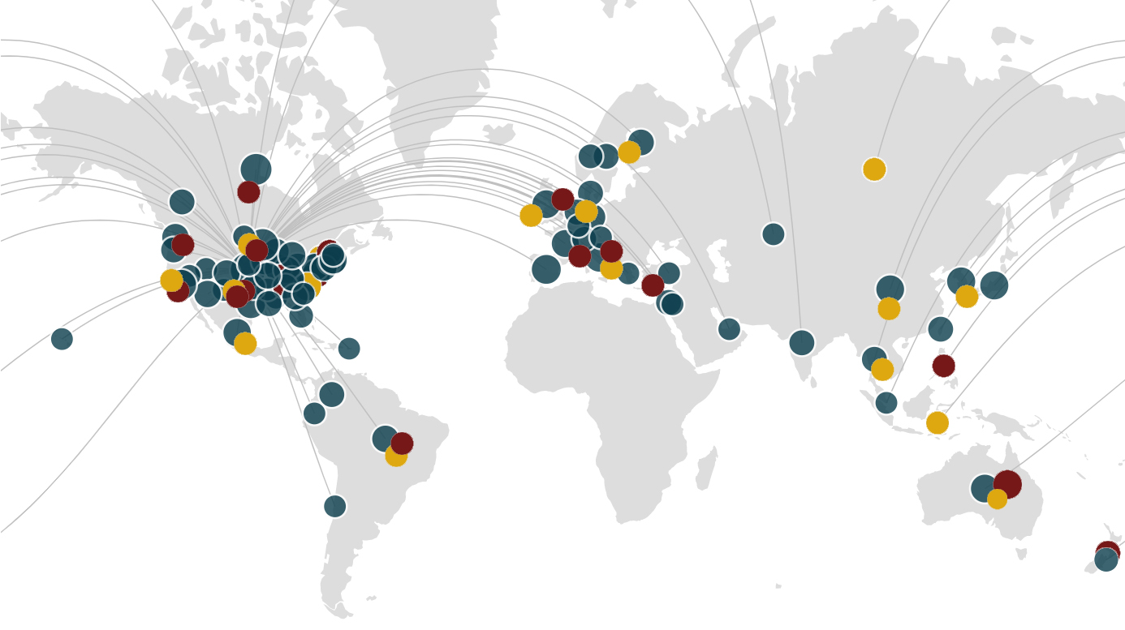
Our connections
Environmental Health Sciences faculty have collaborated with partners in academia, business and industry, and government at the local, state, national and international level through research, outreach, and education.
Universities and Academic Organizations
Government
Business and Industry
Division of Environmental Health Sciences (EnHS)

Slide 10




How do we function?
FACULTY SUPPORT
Division
COMMITTEES
ADDITIONAL
SUPPORT SERVICES
Research
Education and Curriculum
Diversity, Equity and Inclusion
Laboratory
Recruitment
Admissions
Weekly
LUNCH & LEARN
Meetings
Faculty mentoring
Pre-award support
Finance
Student program coordinators
Administrative assistance
Web and graphic design
IT support
Strategic discussions about EnHS mission and direction
Discussion of new initiatives
Brainstorming research ideas and grant proposals
Invited presentations
Faculty development events
Meetings with SPH leadership
Other
Division of Environmental Health Sciences (EnHS)

Slide 11


How do we function?
STUDENT SUPPORT
Student Support
RESOURCES
ADDITIONAL
SUPPORT SERVICES
Program Coordinator
Graduate School
Internships
NIOSH Traineeships
Career Services
Scholarships
Guidebooks
Group Advising
Program Tracks
Graduate Student Services and Progress (GSSP)
Center for Writing Support
University Libraires
One Stop Student Services
Disability Resources Center
Gender and Sexuality Center for Queer and Trans Life
International Student Services
Student Conflict Resolution Center
Student Mental Health
Council of Graduate Students (COGS)
BIPOC Mental Health Collective
Student Counseling Services
Student Academic Success Services
Effective U
Advocacy and Support
Student Parent Help Center
Boynton Health
Division of Environmental Health Sciences (EnHS)

