Slide 1
Long-Term Services and Supports Trust Act
Catherine Kinnaman
Forum on Long-Term Care Financing-Minneapolis, Minnesota
January 7, 2020

Slide 2
What Is Driving State Innovation?
Shifting Demographics
The 65 and over population will more than double and the 85 and older population will more than triple by 2050.
Aging Population
Notes:
<number>

Slide 3

What is Driving State Innovation?
Increasing Demand
Most of us will need long-term services and supports as we age.
7 in 10 individuals over the age of 65 will need long-term services and supports within their lifetimes
Notes:
However, we still face some challenges.
To qualify for Medicaid, there is a $2,000 asset limit. Individuals will have to spend their life savings down to that limit to qualify for financial support.
Medicare does not cover most long-term services and supports.
<number>

Slide 4
What is Driving State Innovation?
Support Families in Caring for Their Loved Ones
    Family caregivers are the backbone of LTSS
    40 million caregivers nationwide provide $470 billion annually in unpaid care
    Care ranges from bathing, dressing, paying bills, transportation
    Almost half perform medical and skilled tasks
Notes:
They are the backbone of the long term care system, providing 80-85% of all long term services and supports
We know that caregiving has a real economic and social impact on families. Including:
Loss of earning potential
Decreased savings for retirement
Impacts on ability to provide for their own children’s needs
Increased health care costs due to stress and burden
We know it is good public policy to support these unpaid family caregivers because not doing so impacts their health and well-being and also would have an immediate impact on our Medicaid spending.
<number>

Slide 5


What Is Driving State Innovation?
Economic and Health Impacts
$
Your out-
of-pocket
expenses exhaust your financial resources
You have a need for care
Your family caregivers become exhausted
You turn to Medicaid for
long-term services and supports
Notes:
The Path to Medicaid is Common and Predictable
If not When and for most of us in this room it is not a question of if we will need Medicaid someday but when we will need it.
The vast majority of long term services and supports 85% is provided by unpaid family caregivers. They are considered the backbone of the nations long term services and supports and the economic value of their contributions are estimated to be over 10.6 billion dollars per year.
Although caregiving can be one of the most rewarding things we can do for a loved one, it is also true that caregiving places emotional and financial burden and stress on the person who is the caregiver. We know that individuals who are caregiving often put the health and well-being of the person they are caring for over their own health, they experience more absenteeism if they are still working and they use their own money to make health purchases for their loved one.
We know that the average cost of LTSS is almost twice as much as the average amount of retirement savings for the average American.
The number of people with private LTC Insurance is dropping (only 7% have it in Washington)
Medicare coverage: Short-term nursing home/No community LTSS
Path is typically: Have a need for assistance to remain independent
A family member steps in and over time there is burnout or the needs become too great to handle
Enter formal care system and pay for needed care
Exhaust savings; become impoverished and qualify for Medicaid
<number>

Slide 6

What is Driving State Innovation?
As Individuals We are Unprepared for Cost of LTSS
More than 90 percent of Americans are uninsured for LTSS.
Medicare does not cover most long-term care.
Personal savings levels are not enough
Average Senior Retirement Savings = $148,000
Average Life Cost of LTSS = $260,000
Notes:
However, we still face some challenges.
Median retirement for people over 65 is $148,000; lifetime cost of care averages $266,000 for those needing care
To qualify for Medicaid, there is a $2,000 asset limit. Individuals will have to spend their life savings down to that limit to qualify for financial support.
Medicare does not cover most long-term services and supports.
<number>

Slide 7
What is Driving State Innovation
States Partner to Pay for Medicaid
Medicaid is the Primary Payer for Long-Term Services and Supports, 2013
Total National LTSS Spending = $310 billion
Notes:
However, we still face some challenges.
To qualify for Medicaid, there is a $2,000 asset limit. Individuals will have to spend their life savings down to that limit to qualify for financial support.
Medicare does not cover most long-term services and supports.
<number>

Slide 8
Washington’s Long-Term Services and Supports Trust Act
An Overview
8

Slide 9

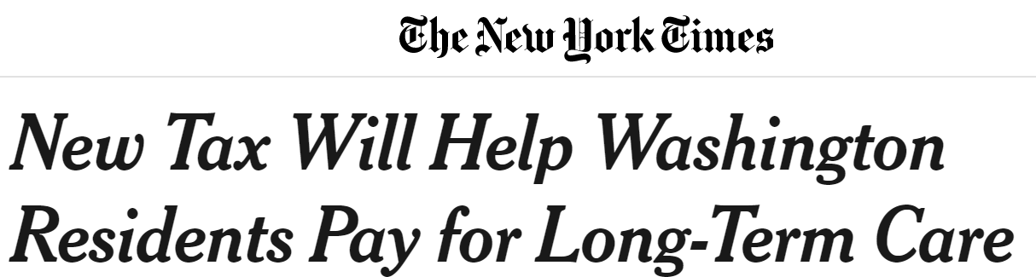





Slide 10
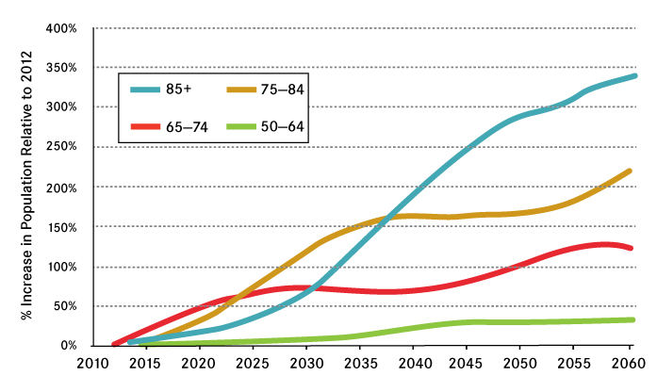
Why this Program is Important
Washington’s Aging Population
Projected Growth of Older Population in Washington as a Percent of the 2012 Population
Source: Washington State Department of Social and Health Services, Research and Data Analysis Division
Notes:
• The number of individuals ages 65 and older has doubled in Washington since 1980.
• The number will more than double again by 2040.
<number>

Slide 11
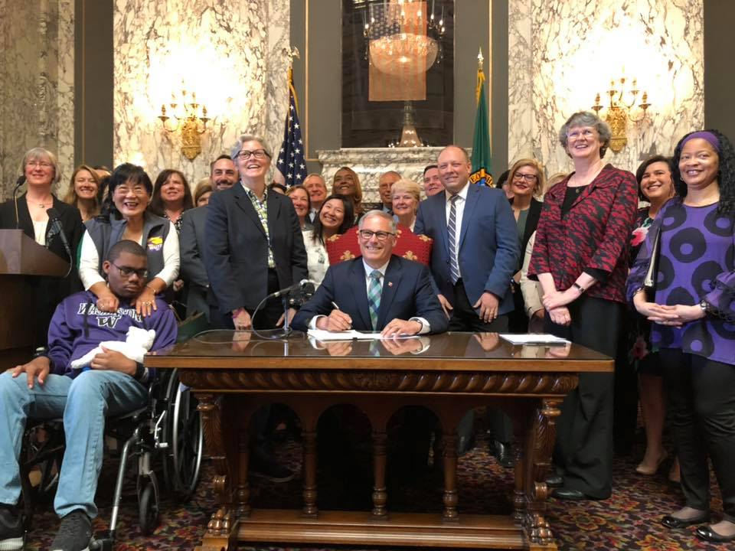

The Legislature Supports an
Innovation Solution
HB 1087 and SB 5331 received bipartisan sponsorship and support
Gov. Jay Inslee signed the bill into law on May 13, 2019
<number>
Notes:
The legislature established a long-term services and supports trust to help individuals pay for their long-term care.
Many of our stakeholders and partners were vocal in their support for the bill.
<number>

Slide 12

What the Law Does
Builds on Washington’s Strengths
High-performing LTSS system by AARP
34th in the nation for LTSS costs to the state
Over 86% of Medicaid recipients receive services in their own homes or local community residential settings
Professionalized LTSS workforce
Paid Family Medical Leave Act
Integrated payment system
Notes:
In many ways, we are prepared for this growing population.
We have a high-quality LTSS system to support Washington’s aging adults.
<number>

Slide 13


What the Law will Do
Trust Contributions
Washington workers will pay up to $0.58 per $100 of income
Every W-2 worker contributes – employers do not
If you are self-employed, you can opt into the Trust to get benefits
If you have long-term care insurance, you can opt out of the Trust
Someone who makes $750 per week will pay $4.35 into the Trust.
Notes:
The Trust Act Commission will determine the rate of pay, which can be up to $0.58 per $100 of income.
<number>

Slide 14

What the Law will Do
The Benefit
In the first year, each person who is eligible to receive the benefit can access services costing up to $36,500
The value of this benefit will increase over time
Notes:
The value of the benefit will increase with inflation.
<number>

Slide 15






What the Law will Do
The Benefit
The benefit can be used for a range of services and supports, including:
Professional care in your home, a licensed residential facility or a nursing facility
Training, pay and support for family members who provide care
Adaptive equipment and technology like wheelchair ramps and medication reminder devices
Home-delivered meals
Home safety evaluations
Rides to the doctor

Slide 16
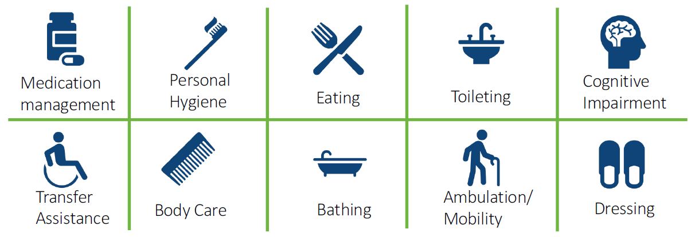
What the Law will Do
Vesting in the Trust & Eligibility
To receive the benefit, you must have worked:
  At least three of the last six years or 10 years without a break of five or more years, and
  At least 500 hours per year during those years
Eligible if you need assistance with at least three activities of daily living
Notes:
ADL requirements are consistent with the state’s Medicaid eligibility (3 ADLS or 2 if you have cognitive needs)
<number>

Slide 17
What the Law will Do
Established Bodies
Trust Commission
Stakeholders
Administrating Agencies
Legislators
Trust Council
Investment Strategy Subcommittee
Non-partisan Investment Experts
Notes:
Trust Commission will have 21 members, including legislators, agencies and stakeholder representatives, including employers.
Trust Council (11 members) responsible for annual benefit adjustments (meets at least once annually)
Investment Strategy Subcommittee responsible for developing a strategy for investing the trust funds
Trust Account Overview
$$ collected from Employment Security Department
Deposited in the Trust Account
$$ managed in custody of the state treasurer
Commission directs the state investment board to invest/manage the account funds.
Trust commission
New oversight/governing body for the program
Legislators
Administrating agencies
Stakeholders and unaffiliated members of the public
Investment strategy sub-committee
Trust council
Legislators and department members of the commission
Annual inflation recommendation
Benefit
36,500 indexed to inflation
Services and supports that can be used
Vesting
Pay the .58% premium on payroll for 10 years or 3 of the past 6 years.
Min hours worked/year of vesting is 500 (approx. 25% time)
Implementation and timeline
Premiums start in 2022.
2025 would be the first year anyone would be vested into the program.
Review of 5000-foot policy overview and context
Benefit: $36,500 indexed to inflation
Supports and services eligible
Eligibility/Vesting
.58% payroll premium
Vested after 10 years or 3 of the past 6 years
Eligible once meet the ADL requirements consistent w/ WA Medicaid eligibility (3 ADLS/ 2 with cognitive needs)
Implementation
Agencies/departments
Trust commission
Trust council
Investment subcommittee
<number>

Slide 18
What the Law will Do
LTSS Trust Commission will Advise, Monitor & Direct
The Commission has 21 members:
4 Washington State Senators
4 Washington State Representatives
Commissioner of Employment Security
Department of Social and Health Services Secretary
Health Care Authority Director
Area Agencies on Aging
Home Care Association
Union representing long-term care workers
An organization representing retired people
An association representing nursing homes and assisted living
An association representing adult family homes
Two individuals receiving LTSS
A worker who is paying the LTSS premium
An organization of employers whose members collect the premium
Notes:
Criteria for determining who is a qualified individual
Criteria for minimum qualifications for providers
Payment maximums for each service
Rules changes to improve the operation of the program
Actions necessary to maintain trust solvency
Adjustments to the benefit unit
Refunding premiums of a deceased qualified individual with a dependent with a developmental disability
Whether or not to extend coverage to individuals who became disabled before the age of 18
Criteria for determining who is a qualified individual
Criteria for minimum qualifications for providers
Payment maximums for each service
Rules changes to improve the operation of the program
Actions necessary to maintain trust solvency
Adjustments to the benefit unit
Refunding premiums of a deceased qualified individual with a dependent with a developmental disability
Whether or not to extend coverage to individuals who became disabled before the age of 18
Establishing an investment strategy subcommittee
Monitoring agency administrative expenses and recommending a method of calculating future agency administrative expenses
Reporting annually to the legislature on the program starting December 1, 2026
Assisting the State Actuary with periodic reports
<number>

Slide 19
What the Law will Do
Administration Shared by Executive Agencies
Employment Security Department
Collects premium and tracks status of vesting
State Medicaid Agency
Processes payments
State Actuary
DSHS (Medicaid Operating Agency)
Tracks benefit usage
Coordinates benefits
Audits and valuates trust to ensure solvency
Establishes
functional
eligibility
Approves providers
Staffs commission, customer service
<number>
Notes:
Criteria for determining who is a qualified individual
Criteria for minimum qualifications for providers
Payment maximums for each service
Rules changes to improve the operation of the program
Actions necessary to maintain trust solvency
Adjustments to the benefit unit
Refunding premiums of a deceased qualified individual with a dependent with a developmental disability
Whether or not to extend coverage to individuals who became disabled before the age of 18
Criteria for determining who is a qualified individual
Criteria for minimum qualifications for providers
Payment maximums for each service
Rules changes to improve the operation of the program
Actions necessary to maintain trust solvency
Adjustments to the benefit unit
Refunding premiums of a deceased qualified individual with a dependent with a developmental disability
Whether or not to extend coverage to individuals who became disabled before the age of 18
Establishing an investment strategy subcommittee
Monitoring agency administrative expenses and recommending a method of calculating future agency administrative expenses
Reporting annually to the legislature on the program starting December 1, 2026
Assisting the State Actuary with periodic reports
<number>

Slide 20
The Numbers Behind the Law
Actuarial Feasibility Estimates
Premium will put $1-1.5 billion annually into the trust account
Approximately 15,000 beneficiaries will be served the first year, climbing to over 40,000 in 20 years
Benefit pay-out is substantial: $0.5 billion in first year
Projected Medicaid savings in first year is $34 million; $3.9 billion by 2052

Slide 21
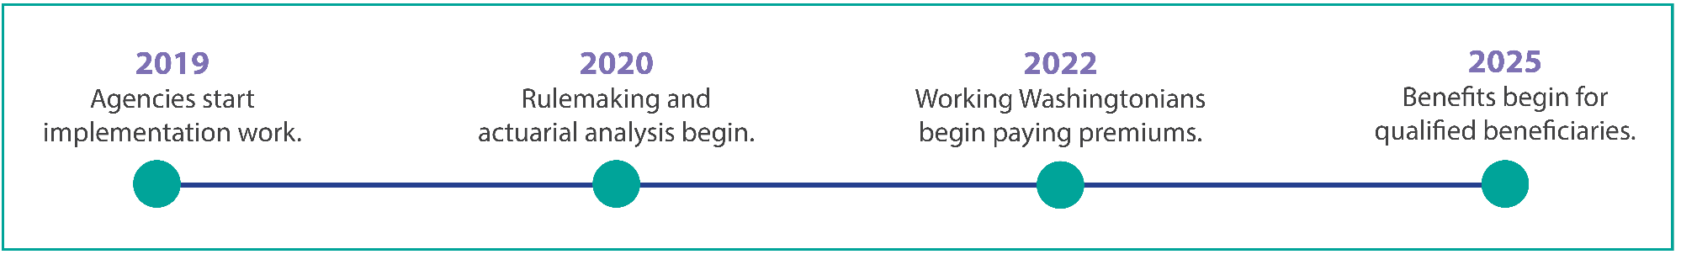
Path Forward
Key Milestones
Commission must report to the legislature in 2021 on:
  Criteria for beneficiaries, providers
  Actuarial reports
  Recommendations to maintain solvency
  Recommendation on whether to amend the law to include individuals with developmental disabilities (following stakeholder consultation)
Notes:
Premiums start in 2022.
2025 would be the first year anyone would be vested into the program. – only people who meet the 3 out of last 6 years criteria
Commission includes legislators, agencies and stakeholder representatives, including employers
<number>

Slide 22

Path Forward
Frequently Asked Questions
How did this bill get developed and passed?
$36,500 per year doesn’t seem like much. What difference will that make?
What are the next steps toward implementation?
What challenges remain?
What are the “lessons learned” for other states?
Notes:
<number>

Slide 23
A Legislature’s Innovative Solution
Action Across Three Biennia
2013-2014
2015-2016
2017
2018
Broad-based coalition formed to tackle LTC financing crisis
Actuarial feasibility completed
Legislators introduce 2017 Long Term Care Trust Act
Passage of SHB 1087
2019
Coalition continues education & outreach
Legislature mandates feasibility study
LTC Trust Act gets bi-partisan support and passed through two committees
National media
Updated feasibility study
Interim stakeholder policy workgroup
Notes:
Passing the bill took 3 sessions
2017 house bill 1636 was heard in the house and health care committee
2018 house bill 2533 passed through house policy and fiscal committees but stalled before floor vote because of stakeholder concerns
2019 house bill 1087 addressed stakeholder concerns with very little opposition
<number>

Slide 24

Who Got Involved?
Coalition of Advocates

Slide 25
Voter Support
There was majority support among voters in all age groups – even with the tax
  An August 2018 poll of Washington voters showed that 73% support the concept of a long-term care trust
  83% of voters ages 18-34 support the concept
Notes:
<number>

Slide 26



Grassroots Ground Game
Strong coalition partners under Washingtonians for a Responsible Future
Tele-townhall with Governor Inslee
7,500 emails and full-page ads in target legislators’ districts
#Prepare4Care hashtag
6,000 Petitions delivered to legislators along with cookies for staff
Notes:
<number>

Slide 27




Using the Benefits
$36,500 doesn’t seem like much. What difference will that make? That's enough for:
25 hours per week of in-home care for a year
5 to 6 months in a nursing home
5 years of family caregiver support that includes respite, caregiver counseling and education, home modification or adaptive equipment
9 to 18 months in a residential care such as an adult family home or assisted living facility
Notes:
<number>

Slide 28
Lessons Learned
What are “lessons learned” for other states?
Don’t be in denial on the need for and cost of long-term care
Accept that LTC costs will press state budgets via Medicaid
Accept that its not “public or private or family or individual responsibility,” it’s “all of those together”
Political 101 – key questions:
  Assess your starting point – is your state already leading on LTC reforms?
  Do you have/can you develop strong legislative champions and leadership?
  Can you build a broad, strong coalition?
Arm yourself with sound actuarial data
Be patient and persistent. This isn’t easy stuff.
Notes:
<number>

Slide 29
Questions?
<number>

